Slide 1
CENIC NGI Project
CIBERTIC 2025
Josh Dickman | AD, Network Services | jdickman@cenic.org
Notes:
introduce myself and position
Today I’m going to be going over the past few years of CENIC’s next generation infrastructure projects and the outcomes we were able to achieve

Slide 2
CENIC is a 501(c)(3) with the mission to advance education and research statewide by providing the world-class network essential for innovation, collaboration, and economic growth.
California State University System
University of California System
California Community Colleges
Stanford
University
University of Southern California System
California K-12 System
Naval Postgraduate School
California Public Libraries
California Institute of Technology
Notes:
First, I’ll start by giving a brief background of CENIC
CENIC is a non-profit research and education network serving the state of California
Founded in 1997, the initial members consisted of
the University of California system
the California State University system
the University of Southern California
Stanford
and Caltech
but eventually encompassed
the K through 12 system
community colleges
public libraries
the Naval Postgraduate School
independent universities
health systems
cultural and artistic organizations
tribal nations
and even museums

Slide 3
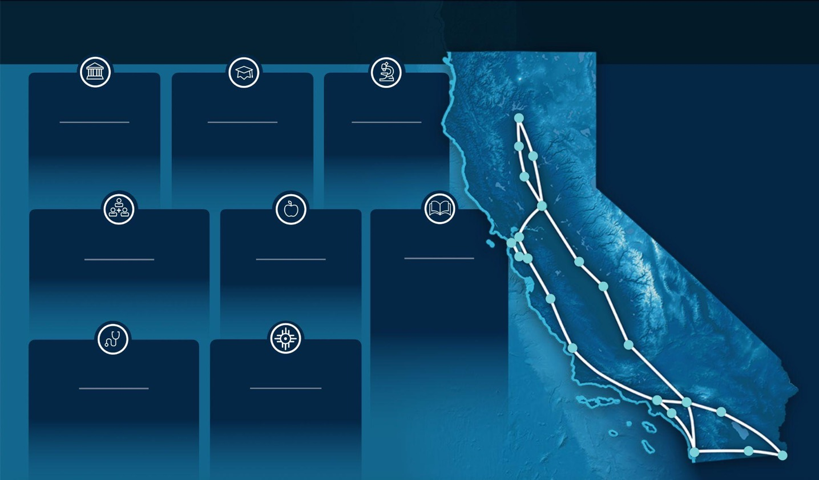
CENIC’s CalREN Serves 20 million+ Californians
Connects over 12,000 sites across all 58 counties
Owns or operates over 8,000 miles of optical fiber
Collaborates with over 800 private-sector partners
University of California
541,573
Students, Faculty & Staff connected to CENIC’s CalREN (spring 2024)
Independent Universities
128,472
Students, Faculty, & Staff connected to CENIC’s CalREN (spring 2024)
California State Univ.
517,997
Students, Faculty & Staff connected to CENIC’s CalREN (fall 2023)
Has spent 28 years connecting California
California Community Colleges
1.9 Million
on 116 campuses (fall 2023)
One of five CC students in US attends a CCC connected to CENIC’s CalREN
California K-12 Schools
5.8 Million
Students, Faculty, & Staff 58 counties, 1,018 districts 10,010 schools (2022/2023)
California Public Libraries
74.1 Million
Visitors (in 2022/2023)
Over 85% of libraries in participating jurisdictions are connecting at 1 Gbps or higher.
Hospitals & Health Care
9 hospitals
Over 10 million outpatient visits and 2 million inpatient days
Over 50,000 employees served
Tribal Nation Partners
12 Tribal Nations
17 Reservations 13 Libraries
~550 homes
105 Tribal municipalities
10/25/24
Notes:
today, CENIC connects over 12000 locations across all 58 counties via CalREN, the California Research and Education Network
CalREN comprises of over 8000 fiber miles and connects over 20 million Californians to the rest of the world
Members connect to CalREN at speeds generally from 1G up to 400G, and recently, San Diego State University became the first institute in the global R&E community to connect at 800Gbps

Slide 4
CENIC Benefits to California Institutions
By using CalREN broadband, CENIC member institutions enjoy supremely reliable, efficient, and cost-effective access as well as these benefits:
Unlimited broadband use
Access to a state-of-the-art network
Entry into a participatory, membership organization
Network design expertise
Cloud connectivity and content services
24/7 Network Operation Center
Scaling services to the need
Federal and state subsidy assistance
Lower costs on circuits & equipment
A global community of tens of thousands of Research & Education institutions
CENIC's California Research and Education Network (CalREN) is a multi-tiered, high-performance network serving the majority of research and education institutions in the state. Each year, 20 million Californians use CalREN at 12,000 member institutions.

Slide 5
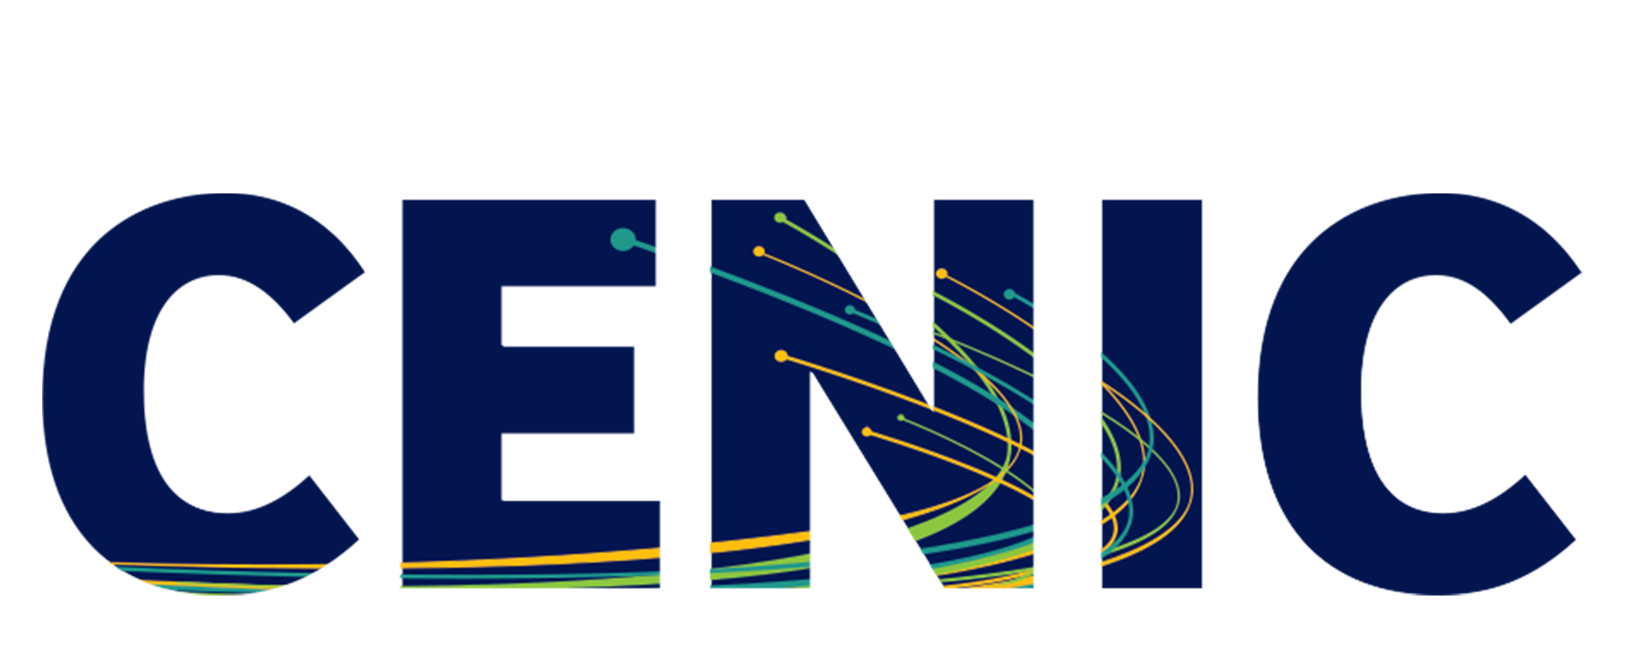
Non-Profit Research and Education Networks: Critical Infrastructure Powering Our Nation’s Most Important Work
HIGHER-ED
INDIGENOUS COMMUNITIES
RESEARCH CENTERS
GOVERNMENT
CENIC connects California to the world – advancing education and research statewide by providing a world-class network essential for innovation, collaboration, and economic growth.
K-12
HEALTHCARE
LIBRARIES
PUBLIC SAFETY
COMMUNITY NON-PROFITS
CULTURAL INSTITUTIONS
Notes:
If there’s one thing to remember from my portion of this, CENIC is not an ISP, it’s a non profit org that operates California’s Research and Education network. We exist only to serve you, our charter members.

Slide 6
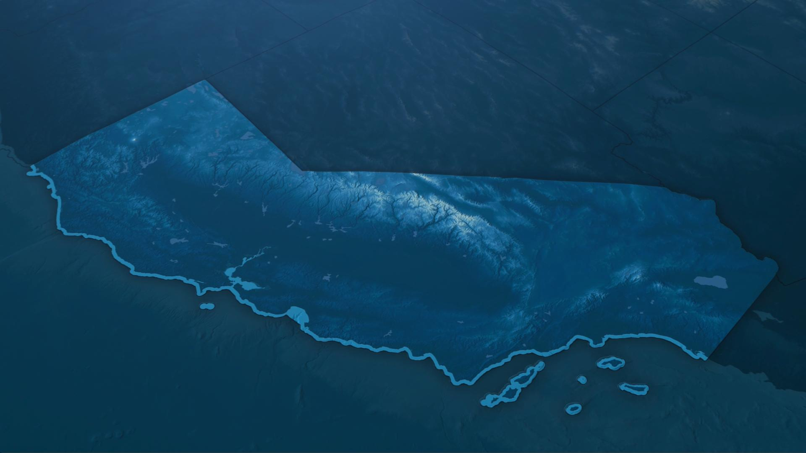
California Research & Education Network (CalREN)
Palo Cedro
Chico
Corning
Colusa
Sacramento
Merced
Fresno
Emeryville
Palm Springs
Yuma
Sunnyvale
Bakersfield
San
Francisco
Riverside
El Centro
Palo Alto
Soledad
Los Angeles
Tustin
San Luis Obispo
San Diego
Tijuana
Notes:
This is the CalREN backbone
We operate our own DWDM network connecting a total of 56 hubsites across the state together using dark fiber IRU assets
The 22 locations shown here are the primary points of presence for optical and routed member connectivity
Like to other carriers CENIC provides connections to the internet.
What is the Internet? The Internet is a network of networks, It is not run by a single entity rather it is a combination of many autonomous networks connecting together through a collaborative effort. As of March 2021 there are about 100,000 global networks connecting together to create the Internet.
CENIC is one of these networks and connects the research and education community of California to the world. We accomplish this by cultivating hundreds of connections with other cloud, content distribution, research, and education organizations.
CENIC is able to do this due to our deep relationships with members of the internet ecology and our substantial user base.
However, CENIC is also different from the traditional carriers. We’re governed by our members which creates a collaborative environment where the members determine CENIC’s goals.
For example, we have a standard Internet network and custom networks tailored to the unique needs of Research and Education. This custom network provides greater flexibility, that Research and Education institutions require to do their data-intensive research.
As Stan had mentioned earlier, through the collaborative environment we have with our members, we’re able listen to their needs. We have deployed a Distributed Denial of Service mitigation service to protect from the threat of attacks across the internet, which have previously taken down Amazon and other major companies. This service has already been used to much success and allowed our members to seamlessly continue operations during these attack.
On the fiscal side as Raul mentioned, due to CENIC’s aggregate buying power in both circuit and equipment, CENIC is able to obtain additional savings which we pass on to our members.
Over the last 3 years, we’ve been engaged on the path towards Next-Generation Infrastructure, an effort to modernize the network. With this effort CENIC’s network will be even more flexible than today.
What’s coming next:
-The capability for our member’s to address their unique needs to extend their network privately and seamlessly across CENIC’s network. This will provide cost savings and ease of member’s network management
-Connections to major cloud providers and connections to Epic an electronic medical record platform which will contribute to better healthcare delivery
-400Gigabit connections… which is 1250 times California’s average statewide speed of 40 MegaBytes per second

Slide 7
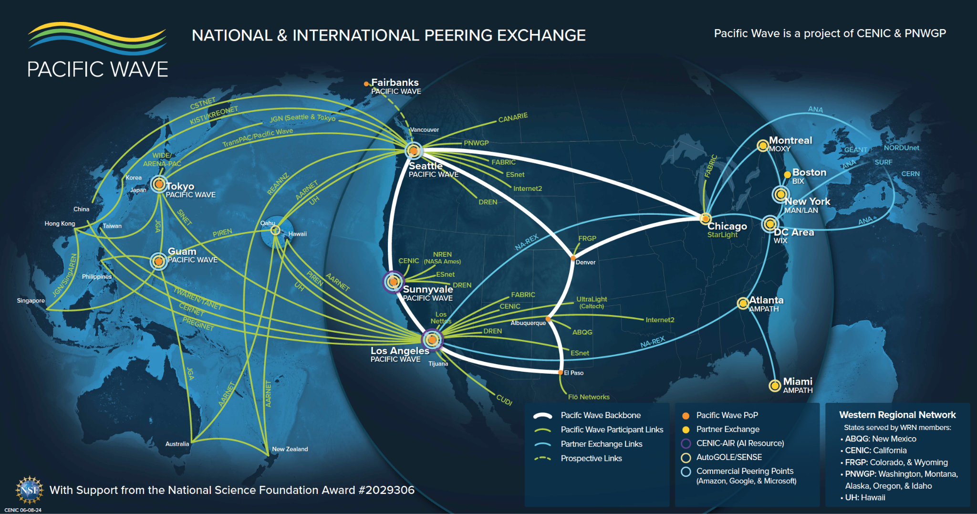
Notes:
In addition to CalREN, CENIC also operates several other networks
Pacific Wave is a joint partnership between CENIC and the Pacific Northwest Gigapop, the REN for the state of Washington
Pacific Wave is a national and international exchange and peering fabric serving global research needs
The major exchange points are currently in Los Angeles and Sunnyvale in California, Seattle Washington, Guam, and Tokyo Japan, with a new Alaska location in-progress that will provide access to important climate research data
This is also how CUDI connects into California, using dark fiber from Tijuana into San Diego
go through the next slides:
CENIC and Pacific Wave also participate in several other key programs, such as
WRN, the Western Regional Network, which connects several states such as Colorado, New Mexico, and Illinois
APONet, the Asia Pacific Oceania Network
GOREX, the Guam Open Research and Education Exchange
NA-REX, the North Atlantic Research and Education Exchange
Joint project of CENIC (California regional research and education network) and PNWGP (US Pacific Northwest regional research and education)
Open Exchange supporting both commercial and R&E peers
Serve 29 countries across the Pacific connecting to the Western US
Supported in part by a grant from the US National Science Foundation (Award 2029306)
We also with our partners in the Pacific Northwest, run an infrastructure called Pacific Wave, which is an international exchange and peering facility for California researchers and their counterparts across the United States -- which provides access to global scale scientific instruments, huge data repositories, and international collaborations -- such as we have witnessed in the response to COVID-19. This network allows our California researchers to have seamless access to colleagues and resources in the Asia Pacific region and Europe. Our major network nodes are in LA, SNVL, Seattle, Guam and Tokyo, and soon, we hope in Fairbanks (for access to the important climate research that goes on among the Arctic nations. Lastly, with our colleagues at Internet2, we run an “express lane” across the us that links West and East Coast Internatinal Research Exchanges. It is important to note that this peering “fabric” is used extensively across all research disciplines, including the arts and clinical research. Mention CERN, sensor nets, distributed data like Cancer Genome (UCSC) and radio telescopes.

Slide 8
Notes:
Western Regional network - UofH, PNWGP, FRGP, UNM, CENIC connecting research and education institutions to leverage shared resources

Slide 10
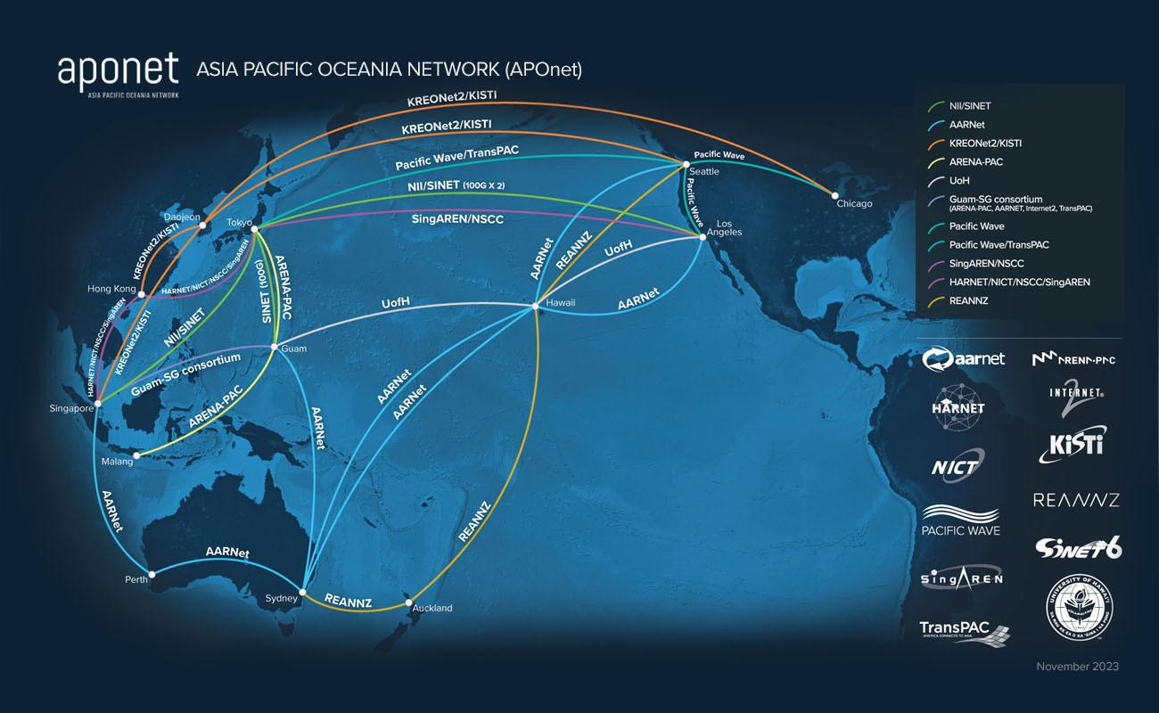

Slide 11
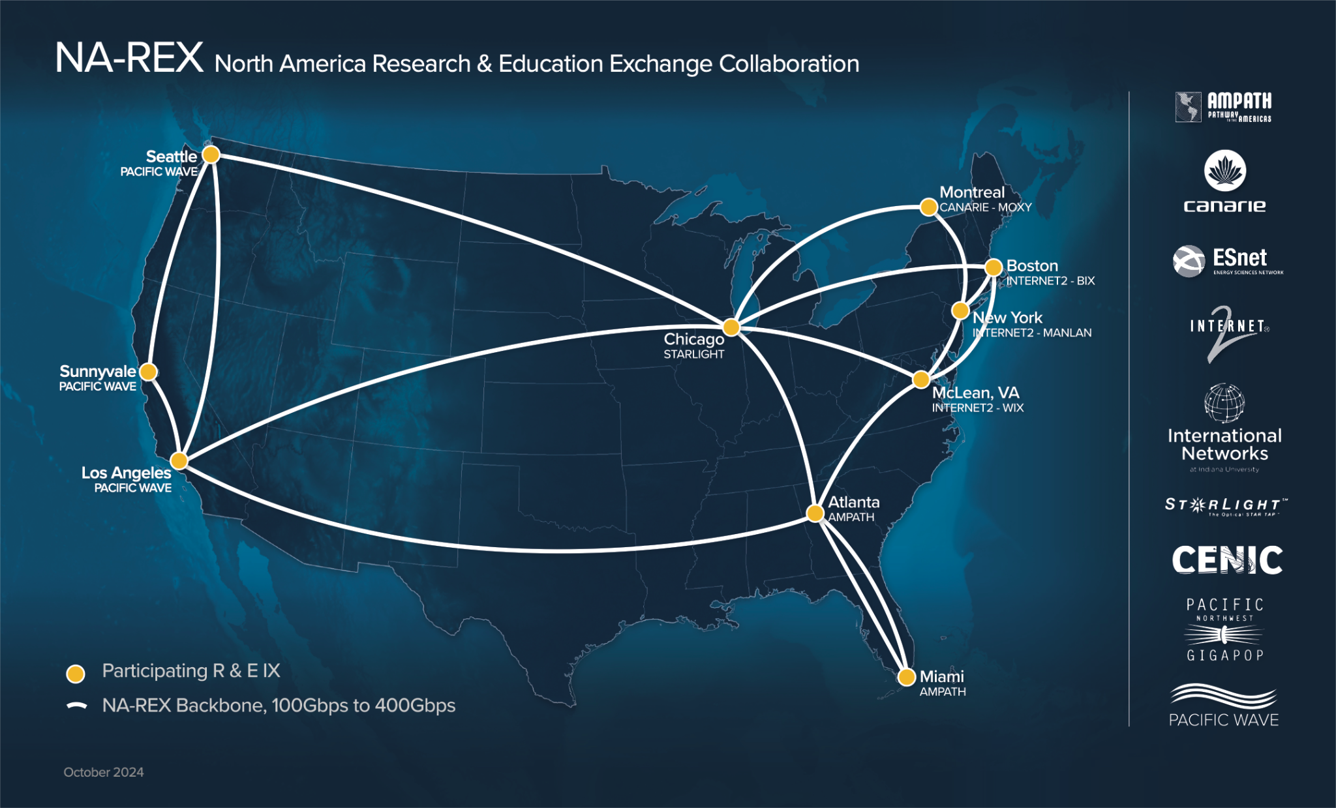

Slide 12
CalREN NGI
2018 - 2025
Notes:
Now that we’ve covered some of CENIC’s background, the next few slides will be focused on our next-generation infrastructure project

Slide 13
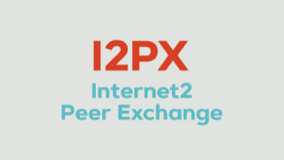
CalREN DC and HPR Networks
DC
Digital California
HPR
High Performance Research
> 8 Tbps of Bandwidth
Internet2 R&E
400G-Based Platform
CENIC
Associate
800G-Based Platform
UC
PacWave R&E Exchange
CSU
CalREN
CENIC
Associate
CCC
K12
Library
CENIC
Associate
Independent
ESnet
LHC1
Notes:
For some background, CENIC operates two distinct Layer 3 networks - the DC network, or Digital California, and the HPR network, or High Performance Research
DC is largely commodity internet access enhanced with direct peerings to major providers, caches, and exchange points
HPR is the global research and education table
by comparison, DC has around one million BGP routes, while HPR has around 60 thousand
After CENIC was founded, HPR was initially the focus, with campuses only using their DC connections as backups to HPR
This meant that for CENIC’s first 10-15 years, HPR got upgrades first with the latest technologies
Over time, as the Internet evolved, this shifted - especially as CENIC members such as the K12 and community college systems joined, which traditionally did not connected to HPR
This meant demand for DC outpaced HPR dramatically, and our focus shifted

Slide 14
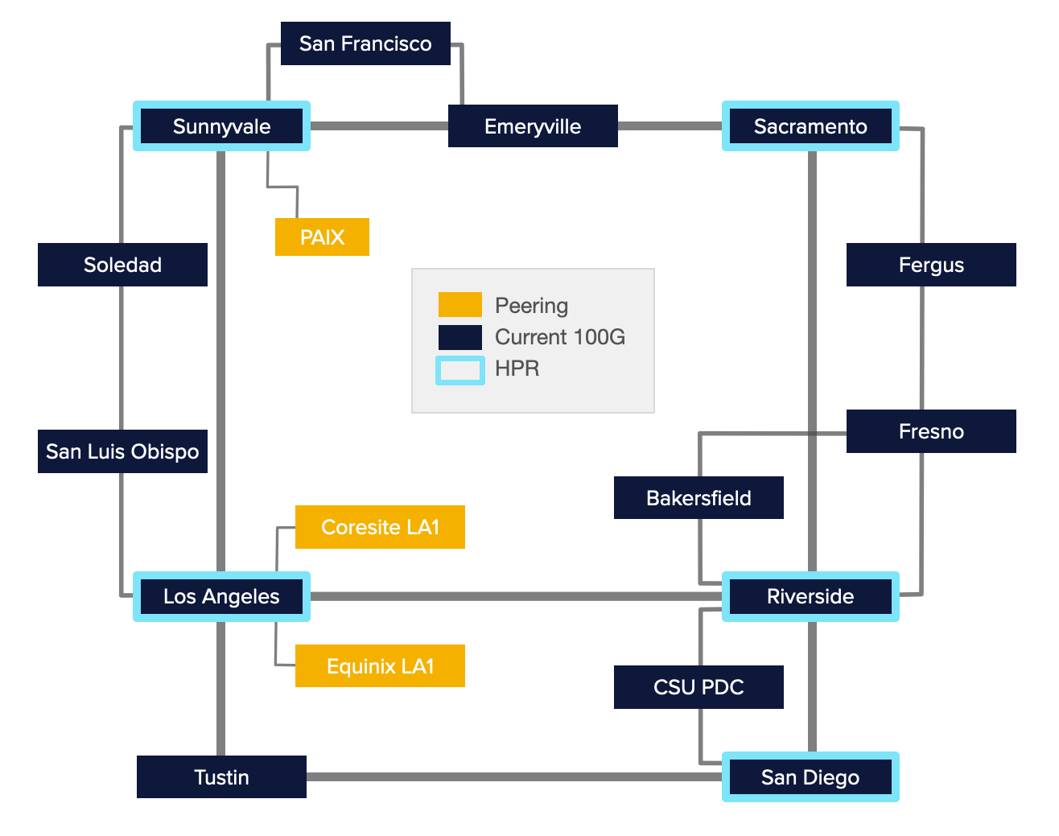
CalREN in 2018
Native IPv4 and IPv6 Only
IS-IS and BGP for IP Services
Separate Ethernet Infrastructure for R&E and Layer 2 Services
Limited HPR locations
Notes:
In 2018, CENIC engineering began taking a hard look at CalREN and its capabilities
Our DC network was primarily on Cisco NCS5508 routers, with some Juniper MX480s sprinkled in
HPR was using Brocade MLX16s, which were nearing End of Support and did not have the protocol capabilities we needed
We could really only support Layer 3 services, with limited support for Layer 2
We also had very limited support for 100G services, and no great options for expanding our 100G footprint or even 400G capability
Note that we could only offer HPR connectivity at five locations, which was the direct result of 1) no overlay capabilities and 2) HPR being on a separate ethernet infrastructure
In summary, we needed to make significant hardware updates and add new services to our catalog, so we began working on our next-generation planning

Slide 15
Next-Gen Goals
Service Offerings
DC & HPR Everywhere
L2VPN
Dynamic | Explicit
Efficient Multicast | mLDP Replication
PE-CE Multihoming
PE-CE Significant VLANs
L3VPN | IPVPN
Multicast Ready
Flexible PE-CE Protocols | eBGP and iBGP
Traffic Class Specific Topologies
i.e. Flex-Algo - Least Delay
HQoS
MPLS
Segment Routing
Additional Features
Resiliency:
BFD | Micro BFD
LFA | TI-LFA
BGP-PIC Edge & Core
Service Assurance:
CFM (Connectivity Fault Management)
Forwarding Flexibility:
Shared Services Model
Stateless TE
Traffic Class-based Topologies
Extension of Services via PWHE
Logical Tunnels
Security
BCP38 (Anti-Spoofing)
400G-Based Platform
800G-Based Platform
Notes:
This slide shows many of the protocol and technology changes that we wanted to see happen
One of the primary goals was to be able to offer HPR and DC services at all locations
The best option for this was to consolidate HPR onto the same physical hardware as DC and treat HPR as a virtual routing table
We also wanted to support flexible layer 2 and layer 3 overlay services, which meant we needed to move to an MPLS-based network
For MPLS, at the time, the options were the more legacy LDP and RSVP protocols in addition to the up and coming Segment Routing
Given that we already ran IS-IS, and since segment routing does not need to maintain state for each LSP, Segment Routing was the logical choice
This also led to an easy choice of EVPN for Layer 2 overlay services instead of VPLS
and there were also notable individual improvements that we aligned to such as multi-level resiliency with Micro BFD, TI-LFA and BGP PIC
Hierarchical QoS was also top of mind as we had multiple levels of port fanout that were not being used effectively
Lastly, we also wanted to improve 100G capabilities, and add support for 400G (and later 800G)
This slide seems a lot but this is a part of our NGI goals that we tracked towards to.
CENIC used to operate two independent hardware infrastructure for the DC and HPR networks that have different availability by location. DC is for Digital California which is serves as our commodity internet service and HPR is for the High Perfomance network which servers as our R&E service.
Given that both services’ infrastructure are not available in all locations we wanted to make it a goal for our NGI to be able to offer the service in any location that has a router.
As for new services, L2VPNs and L3VPNs was selected as both can boost our service catalog when used in different variations and combinations
HQoS was also top of mind as we had multiple levels of port fanout that was not being used effectively
In order to realize the some of the new service offerings, we knew that we had to go beyond native IP and Bridging so we looked into MPLS
At the time, it was LDP, RSVP and the up and coming Segment Routing. Given that we already ran IS-IS and Segment Routing not having state overhead for each LSP we decided to make IS-IS SR a goal
There were also notable individual improvements that we aligned to such as multi-level resiliency with Micro BFD, TI-LFA and BGP PIC as well as flexible tunneling options like PWHE and Logical Tunnels
Lastly, we wanted be able to have anti-spoofing and filtering capabilities at scale without losing functionality nor scale

Slide 16
Next-Gen Goals cont’d
Scalable and Cost-Effective: Lower Cost-per-Gigabit to allow for sustainable growth
Ease of Adding Capacity: Simplified capacity expansion even through generation upgrades
Reduction in Carbon Footprint: Consolidation of dedicated resources to drive more efficiency and lower consumption of Space, Power, and Cooling
CapEx and OpEx Savings: Achieving the roadmap goals while keeping costs lower
Better Protocols for Automation: Reducing the complexity in automating the new VPN Services
400G-Based Platform
800G-Based Platform
Notes:
On the business side we saw significant opportunities for cost savings such as
consolidating HPR and DC hardware to one device and moving away from legacy optical platforms, which reduced maintenance spend and colocation costs
simplified backbone upgrade cycles
and Automation to drive standardization, reducing demands on engineer time and improve network determinism

Slide 17
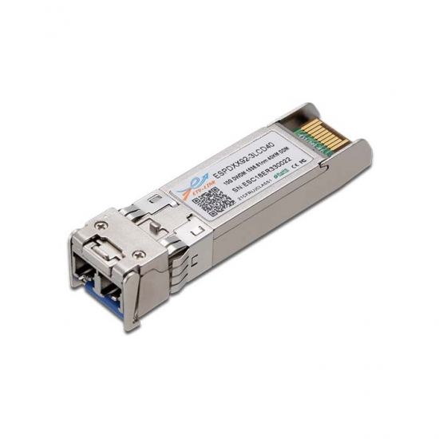
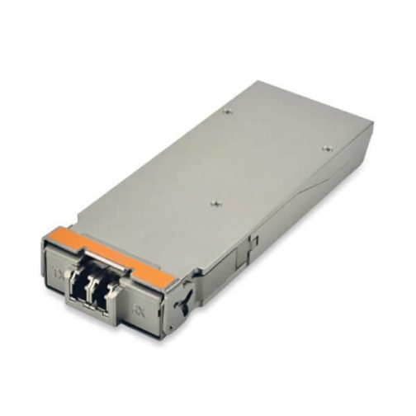
DWDM Background
To support services above 200G, we needed to first upgrade to a flex-grid optical network
Legacy DWDM has fixed 50Ghz channel spacing, while flex-grid is ‘flexible’
Secondly, optical hardware for above 200G requires coherent optics
Legacy optics modulate with ‘on-off keying’, while coherent optics modulate phase / amplitude
800G-Based Platform
Fixed-Grid
Flex-Grid
50Ghz
50Ghz
50Ghz
50Ghz
50Ghz
37Ghz
75Ghz
125Ghz
50Ghz
Non-Coherent
Optics
Coherent
Optics
Notes:
One of the major challenges, which we’re actually still working through, is on the DWDM layer
DWDM, or Dense Wavelength Division multiplexing, is a very deep subject, but one of its main purposes is to connect remote sites together
We didn’t take a count in 2018, but I estimate we had around 400 optical services on CalREN at the time
A very large portion of these are at speeds below 100G, meaning they’re non-coherent
For the next-gen optical network, flex-grid hardware and coherent optics are required to support speeds above 200G
At a very very high level
flex-grid allows optical services to be provisioned with flexible channel sizes instead of fixed 50Ghz blocks
400G, for example, generally requires 75Ghz
Coherent optics are used to encode more information in a given channel size by modulating amplitude and phase
The result is that in order to achieve a 400G backbone, we first needed to remove non-coherent optical services
in other words, any circuits below a speed of 100G needed to be changed
This was, and still is, a major effort

Slide 18
CalREN and Next Generation Infrastructure (NGI) Timeline
2018
Migration of 10G optical services over the core segments of the southern route to coherent transponders
2020
Migration of 10G optical services over the core segments of the coastal route to coherent transponders
Enabling of Flexible grid over the core segments of the coastal route
2022
Deployment & Migration of CENIC’s backbone services over the southern route and the coastal route from Nx100G to 300G+ services
Merging of the Southern route and the Coastal route
Migration of 10G optical services over the core segments of the Inland route to coherent transponders.
Field testing of coherent pluggables
2024
Refresh EOL devices with MX10003
Upgrade MX10008 to support 400G
Refresh Coastal Route Optical Line System with NCS1010
COVID-19 Begins
2018
2019
2020
2021
2022
2023
2024
2025
2019
Enabling of Flexible grid over the core segments of the southern route
2021
Adding CDC infrastructure in LA and in Sunnyvale.
Enabling the first set 100Ghz+ spectrum services over the coastal route for Pacific Wave and for Internet2
2023
Enabling flexible grid and CDC at the optical nodes on the Inland route
Migration of CENIC’s backbone services over the Inland route from Nx100G to 300G+ services
Merging of the Inland route with the Coastal/Southern route
Deployment of coherent pluggables in production
Something about HPR
2025
Refresh Inland Route Optical Line System with NCS1010
Enabling support for BGP Classful Transport to support future Inter-AS optimizations with other networks.
Enabling support for Segment Routing Traffic Engineering with Flex Algorithm.
Notes:
This is a high-level timeline of the NGI refresh up to 2025
A large portion of the work was actually on the optical layer as I mentioned on the previous slide, but we also deployed new backbone routers and made major routing config changes as well
The sub-100G services are being either multiplexed onto larger 100G trunks, or deprecated in favor of a Layer 2 VPN overlay service
In almost all cases, this ends up beneficial to our members because of the generally high cost for native optical services
During all this, we also, like everyone else, were significantly impacted by COVID-19 related delays, and we also had to deal with our colocation provider Equinix closing one of our major locations in Los Angeles
Began with optical backbone migrations and upgrades to flex grid
refresh of backbone routers
dealt with COVID supply chain issues, which also resulted in some surprising end of life announcements
Los Angeles hubsite closure
COVID supply chain issues and tariffs, which also resulted in surprising End of Life announcements
Initial rounds of optical upgrades without secondary fiber were very challenging
Many members had procured 1G and 10G optical services across the backbone, which need to be migrated to L2VPNs or multiplexed to 100G trunks
lack of pre- and post-migration testing automation
legacy and non-standard configurations when migrating to new hardware

Slide 19
CalREN in 2025
Layer 1
Flex-grid Cisco NCS2Ks
Cisco NCS1010 upgrades in-progress
Cisco ONC transition in-progress
IPoDWDM using 400G ZR+ optics
Layer 2/3
Juniper MX480/10003/10008s
DC and HPR on same hardware
ISIS Segment Routing
EVPN
ELINE
Dynamic & Explicit Path
ELAN
Port- or VLAN-based
IPVPN
Bandwidth Availability
100G support at all Layer 3 locations
400G support on all 7 ‘core’ locations
800G support in-progress using PTX10002s
Additional Features
Resiliency:
BFD
BGP-PIC Edge & Core
TI-LFA
Security
BCP38
RPKI
Notes:
This slide sums the CalREN NGI project up to today
We upgraded 14 backbone routers, which involved migrating around 2000 member circuits
Consolidated the HPR research network and the DC commodity network to a shared infrastructure using VRFs
Completed flex-grid optical upgrades on the CalREN Coastal and Southern fiber routes, enabling superchannel support for circuits above 200Gbps
Transitioned from a flat IP network to a fully segment routing based backbone
Migrated all Layer 2 services to EVPN-based solutions, which also resulted in a significant increase in demand for these same services, particularly for cloud applications
and finally, we upgraded the backbone to 2x400G, with the final two spans completing next month

Slide 20
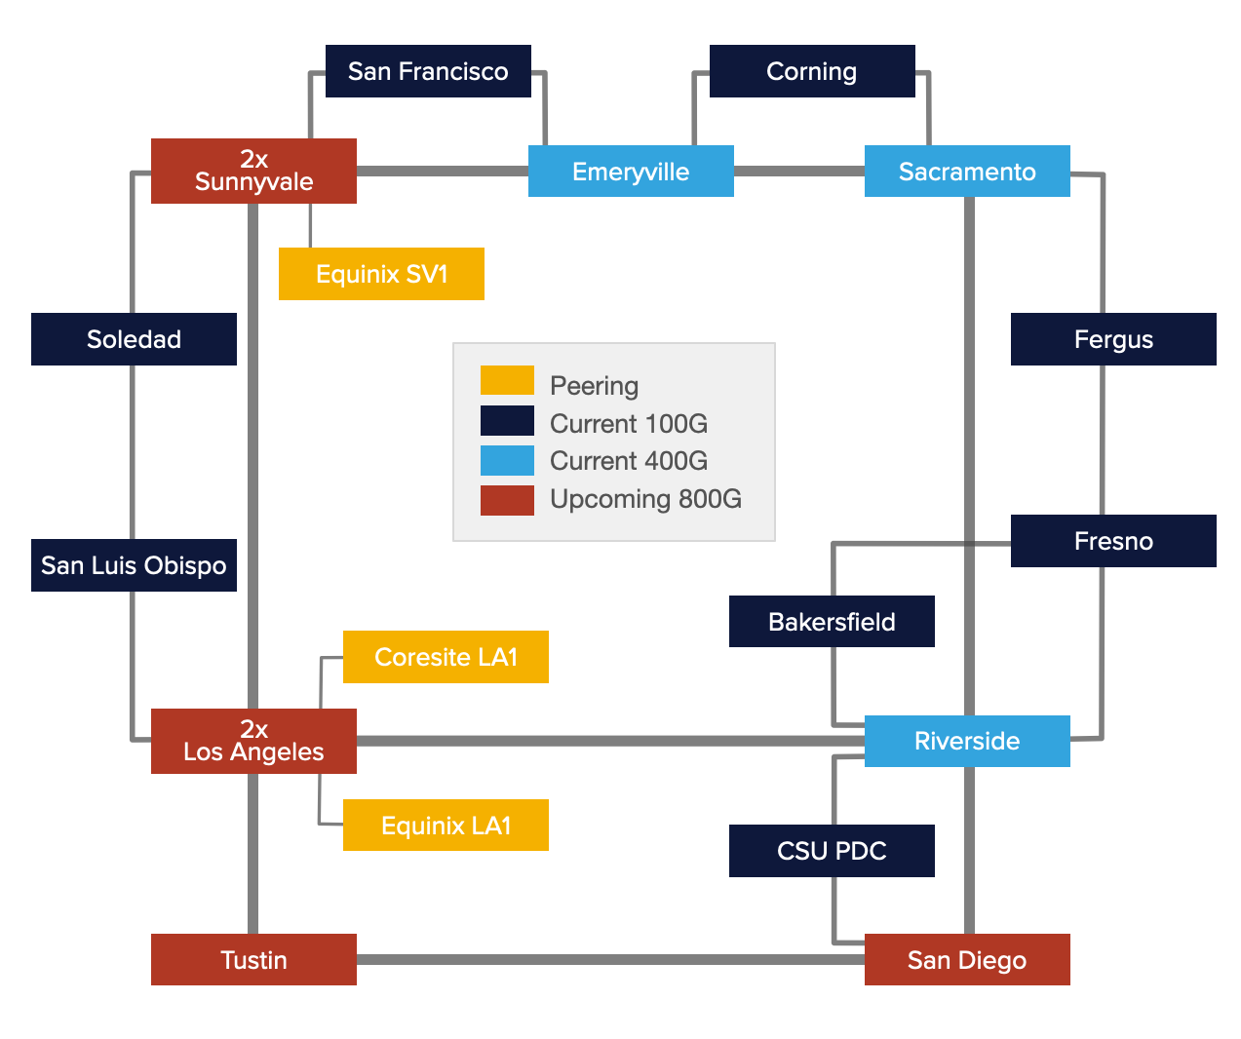
Current CalREN Network
Notes:
this is another high-level diagram showing the state of the backbone today
note that HPR is now available at all locations
Several of the sites are colored red now to signify 800G support, which I’ll cover later

Slide 21
NGI - Hardware
Notes:
Next, we’ll talk about some of the hardware changes during the NGI project
10 minutes to here

Slide 22
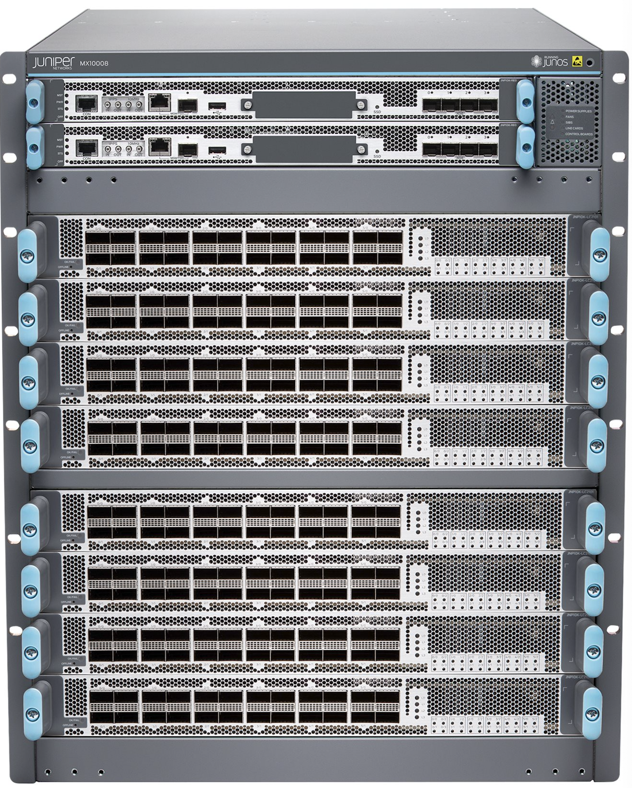
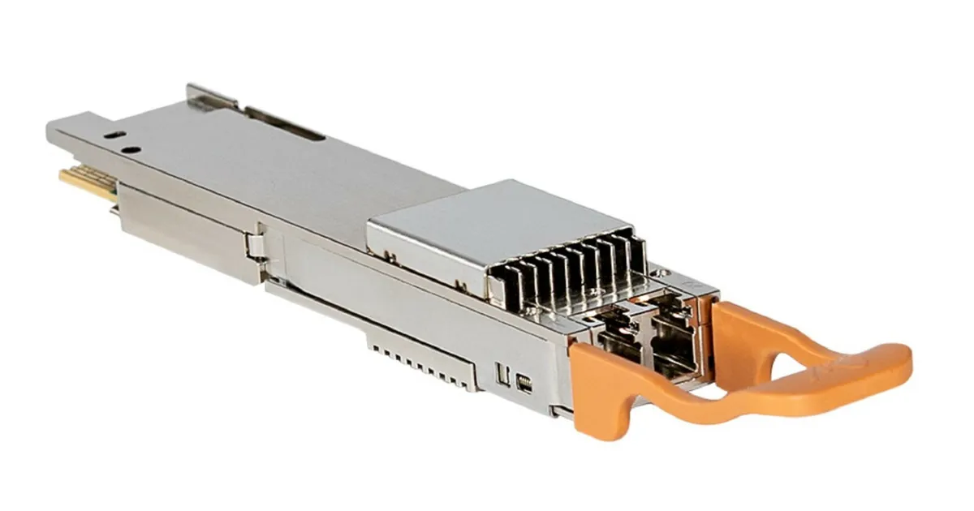
Aggregation Router - Juniper 400G Line Cards
Replace 100G Line Cards
with
High-Capacity 400G Line Cards
High Capacity
400G card supports 9.6T/Slot
vs
100G card supports 2.4T/Slot
Future Ready
Support 400G ZR+ and 400G grey optics
Backward Compatibility
Support 100Gs by using break-outs
Juniper MX10008
x4
+
400G Coherent Optics
400G tech
100G tech
LC9600 400G Line Card
Notes:
first, we started by upgrading our legacy backbone routers to Juniper MX10008s (shown above) and MX10003s (which are not shown here)
the 10003s are used at some of the lower demand locations for 100G connectivity, but do not support 400G services
the 10008s are our primary backbone routers today, used at all major hubsites
Using the LC9600 line cards, they support 100 and 400G connectivity, and support the new 400G ZR+ optic types, giving us a high amount of capacity and flexibility

Slide 23
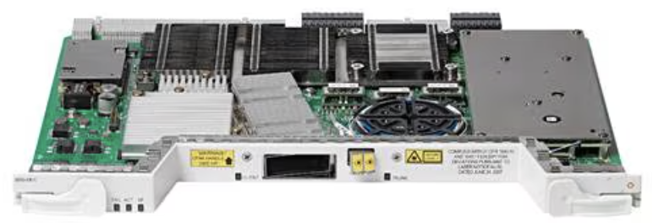
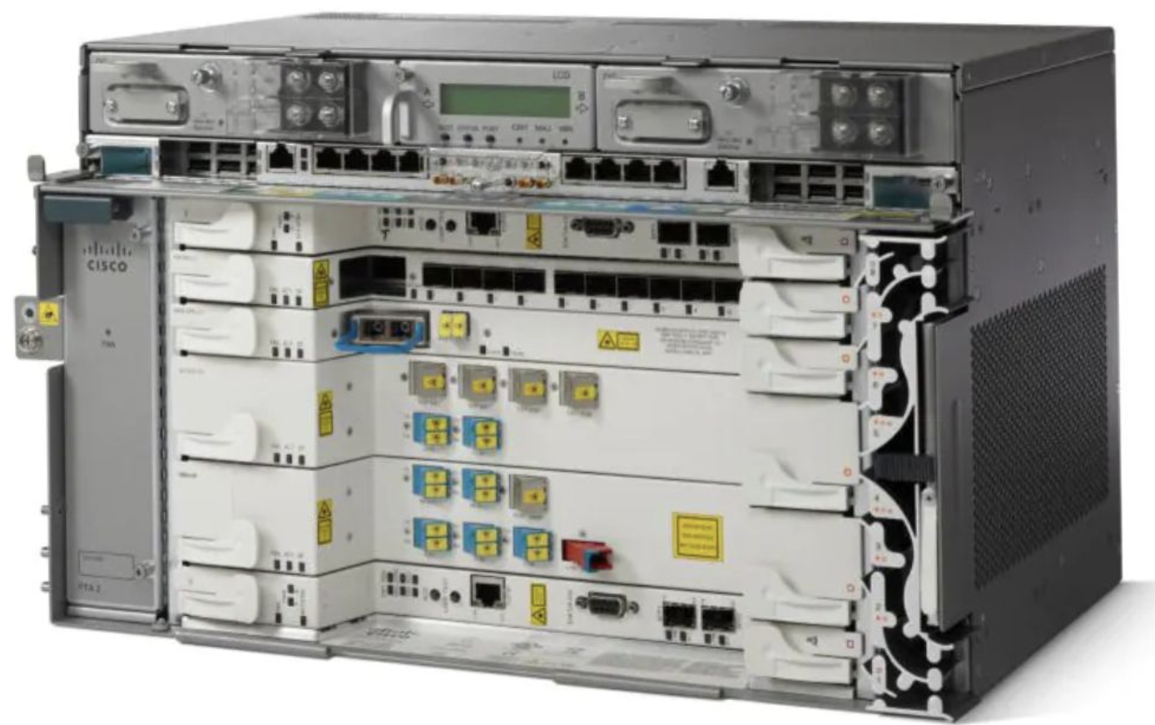
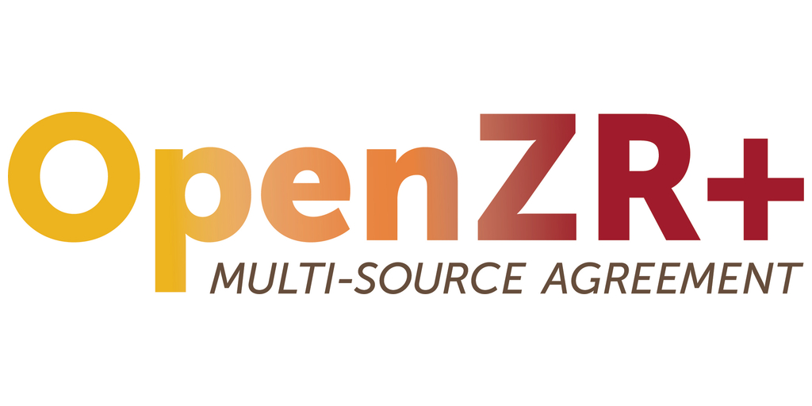
Digital Coherent Optics - 400ZR+ Optics
Using IPoWDM, 400ZR+ optics are inserted directly in Aggregation Routers to replace external 100G transponders
Legacy 400G Solution
REPLACED
400G IPoWDM Solution
+
400ZR+ Digital Coherent Optics
NCS2006 Shelf
4x 100G Transponder
400ZR+ Coherent Optics
Bulky Cisco NCS2K Shelf(s) with 4x100G Transponder
400G QSFP-DD inserted directly in Agg router
Complex
Expensive
End-of-Life
Simpler
Economical
Next-Gen Technology
Notes:
One of the most significant hardware advancements has been on the optics side
With 100G, there were very limited options for coherent optics that can be inserted directly into a router
This meant that almost all 100G applications required discrete, and therefore expensive and more complex, transponders
In addition to the higher cost, most of these legacy transponders are now nearing End of Life
With 400G, the ZR+ and ZR+ high power optics can be inserted into a 400G-ready router and transmit a coherent signal directly into the optical line system
This offers huge cost savings compared to the legacy transponder design, and the CalREN NGI project has been heavily utilizing them
for comparison, a 400G wave can be deployed for approximately the same hardware cost as a 10G wave costed 5 years ago
By the end of next year, almost all backbone services are expected to be using these new optics

Slide 24
IPoWDM – Solution Highlights
IPoWDM is simply using coherent DWDM pluggable optics in IP routers and switches.
The easiest place to start in the journey is replacing external transponders with OpenZR+ QSFP-DD transceivers.
This will allow CENIC to achieve 400GbE capacity and beyond, while eliminating the need for costly external transponder infrastructure.
Coherent 400G DCO ZRP

Slide 25
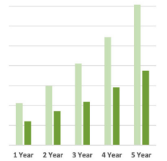
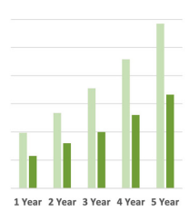
CAPEX and OPEX Savings
TCO Saving Estimates
IPoWDM Solution
Environmental Efficiency
Cumulative TCO
Cumulative CAPEX
54%
Power Savings
45%
TCO Saving compared to Router + Transponder
77%
Space Savings
40%
CAPEX Saving compared to Router + Transponder
55%
Carbon Footprint Savings
Notes:
Using these DWDM pluggables at 400G, and 800G as we’ll see later, we’re already realizing some significant cost reductions in our space and power consumption

Slide 26
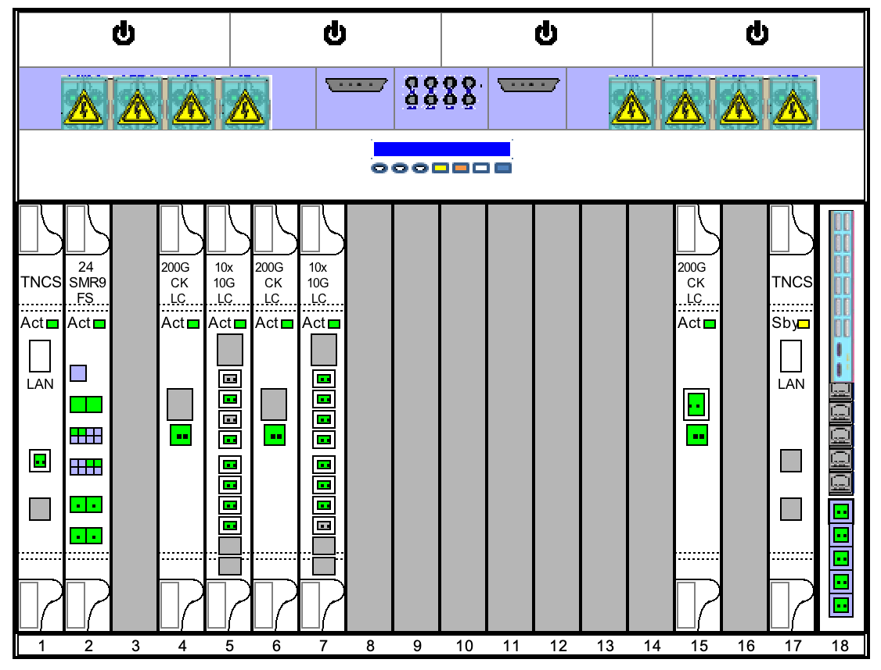
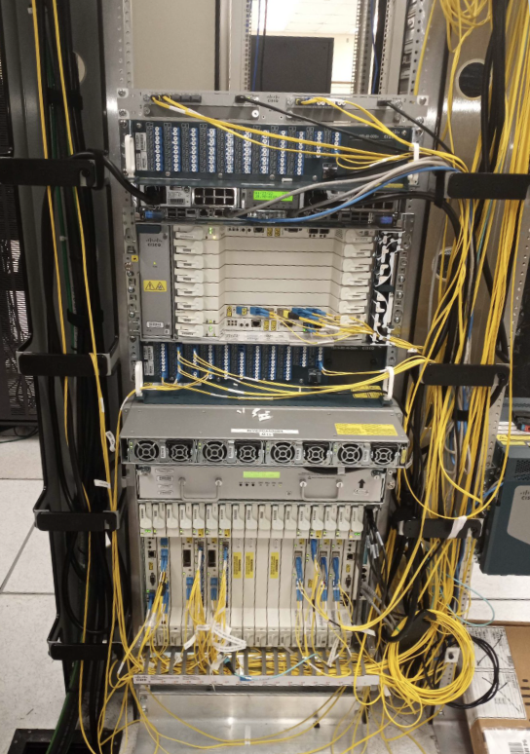
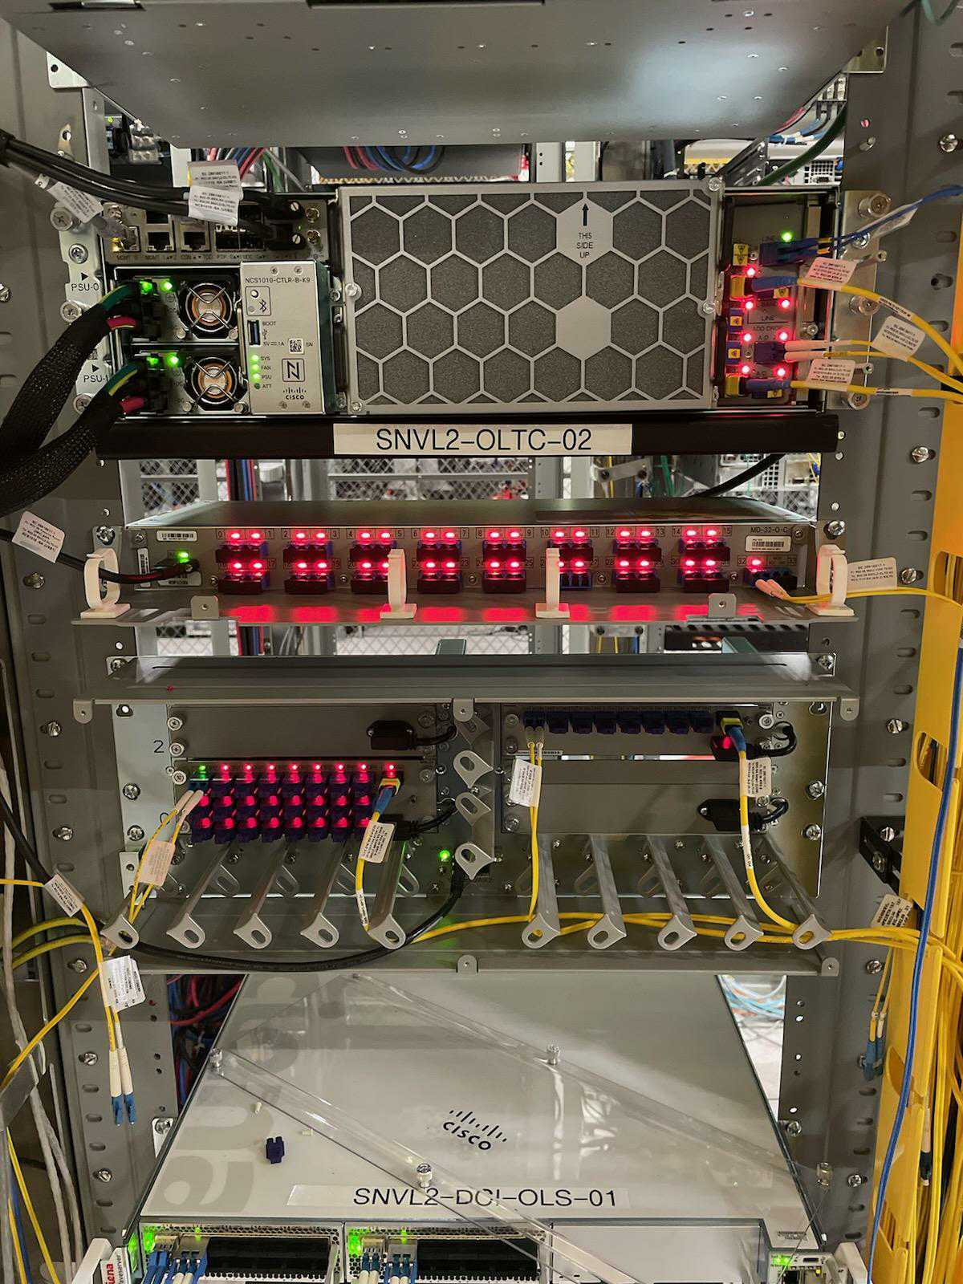
Greener - Power & Space Saving
8RU
14in
25RU
43.75in
NCS1010 Setup
Total Consumption: ~1740 Watts
Total Consumption: ~200 Watts
NCS2K Setup
Power Savings of 88.5%
Space Savings of 68%
Notes:
For comparison, on the left is a 3x100G using the legacy NCS2K platform and 100G transponders
on the right is the 400G ZR pluggables and the newer NCS1010 open line system
As you can see, this is an almost 90% reduction in power, and almost 70% reduction in space

Slide 27
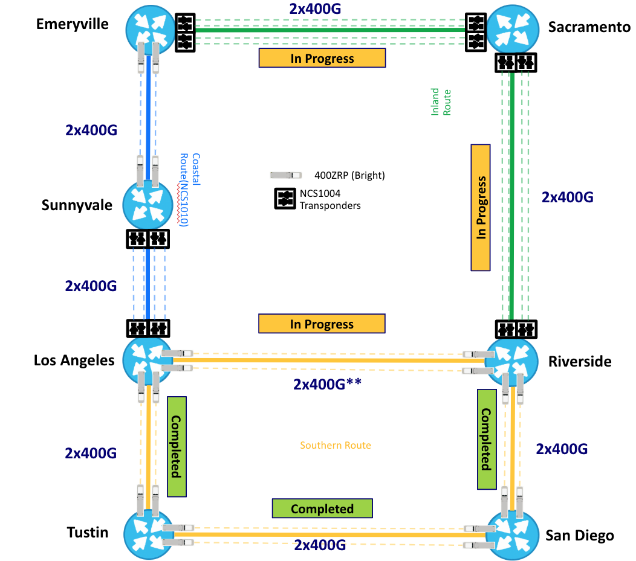
CalREN Core Ring 2025
400G ZR+ pluggables where possible
Dedicated transponders for longer spans
Upcoming 1x400G upgrades to low-demand locations using Juniper ACX7348s
Notes:
This diagram shows what we call the CalREN Core Ring, which consists of all the major hubsites
We’re using 400G pluggables where possible, and we expect to have the 2x400G upgrade completed in by June
The LA - SVL and SAC - RIV paths are too long for ZR+ pluggables, but everywhere else we expect to be able to utlize pluggables
This allows us to very easily, quickly, and cheaply upgrade our backbone capacity as needed.
For the lower-demand locations, such as Fresno or San Luis Obispo, we’re in the process of purchasing ACX7348s to replace non-400G capable routers so we can continue leveraging 400G pluggables

Slide 28
NGI - Pacific Wave
Notes:
While all these CalREN upgrades were going on, we were also working with our partners at PNWGP to upgrade Pacific Wave

Slide 29
Pacific Wave - 400Gbps Online
Juniper PTX10001 deployed in production at all sites
West Coast 400Gbps backbone upgrade complete
Participant 400Gbps connections online!
SINET
PNWGP & CENIC
ESnet
Notes:
PacWave uses similar platforms as CalREN
Originally they were using the same MX10008s as CENIC to delivery 100G services
Instead of the plan CENIC used for CalREN, which was to upgrade these MX10008s to support 400G, for PacWave it made more sense to switch to a new platform - the PTX10001
This PTX router offers 400G support out of the box, and is currently being used at Seattle, LA, and Sunnyvale to create a 400G PacWave backbone, shown here

Slide 30
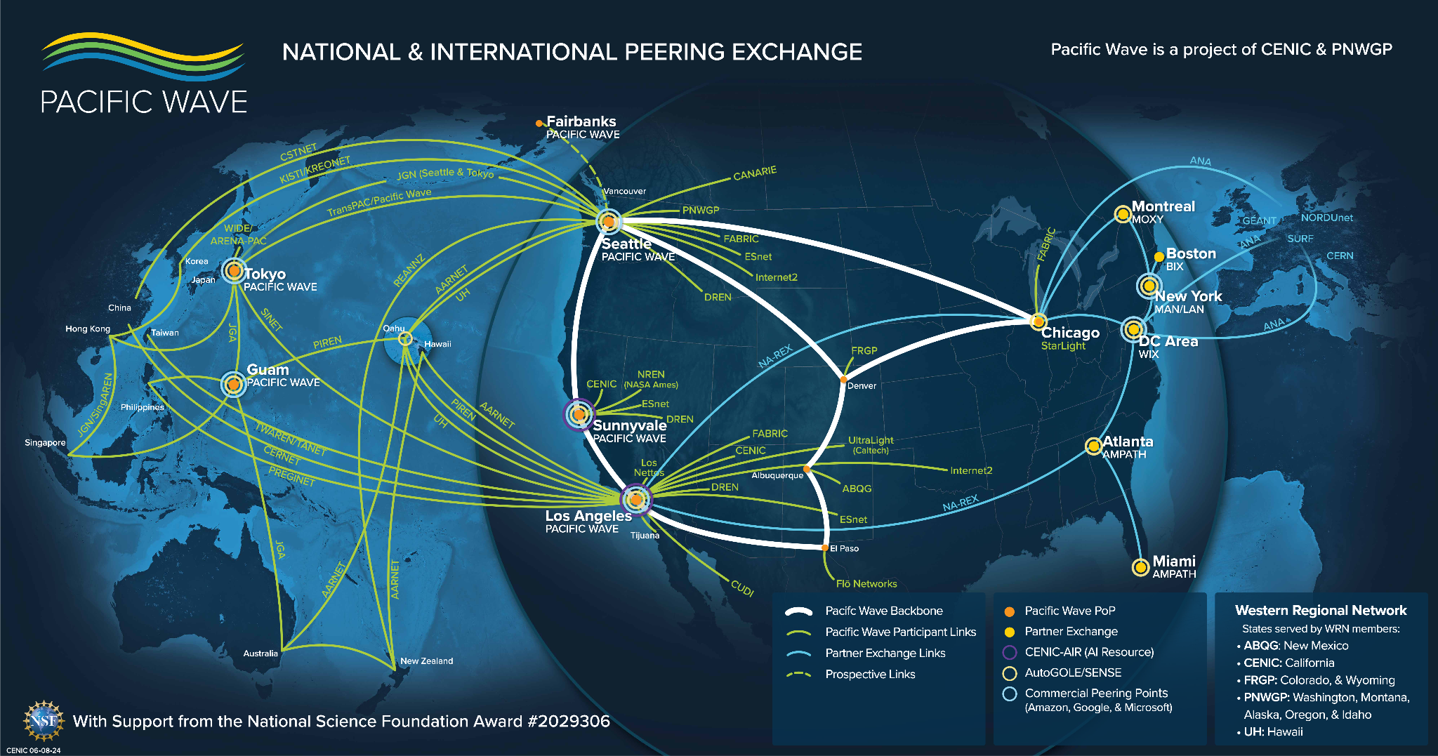
400G-Based Platform
800G-Based Platform

Slide 31
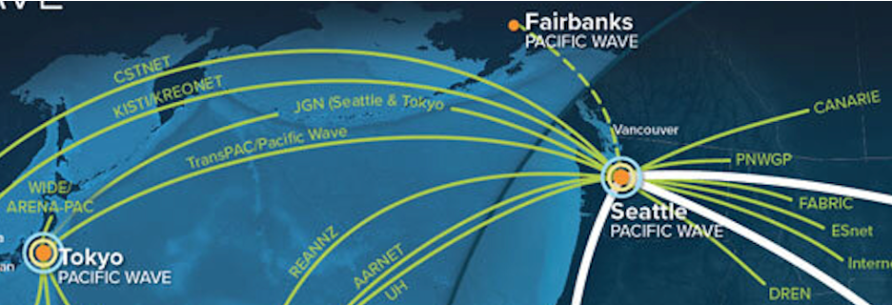
Pacific Wave in Alaska
Node deployment in Fairbanks, AK
Collaborating with MTA & University of Alaska
Provide local peering and connectivity
Notes:
We’re also in the planning and procurement phase for a new PacWave node site in Fairbanks, Alaska

Slide 32
NGI - CalREN Services
Notes:
as a result of the NGI project as a whole, we have a new, updated service catalog, which I’ll briefly go through
14 minutes to here

Slide 33
CENIC Service Overview – 2024
Primary Network Services:
CalREN Digital California (DC)
CalREN High Performance Research (HPR)
MPLS VPN Services:
L2 VPN Network Service – E-LINE
L2 VPN Network Service – E-LAN
L3 VPN Network Service – IP-VPN
Layer 1 Services:
Optical Service
Optical Spectrum as a Service
Other Network Services:
CENIC Rapid Private Interconnect (RPI)
CENIC DDoS Mitigation Service (DMS)
CENIC AIR ScienceDMZ (New!)
Internet2 Services available via CENIC:
Internet2 AL2S
Internet2 Cloud Connect
Internet2 RPI
Internet2 InCommon & Net+ Services
Notes:
A quick overview of our service catalog. I wont take the time to go through all of them, but we’ll go through some of the highlights

Slide 34
Digital California (DC)
Used by majority of CENIC members
Connectivity to general Internet
Direct connectivity to other CENIC members
Transit, peering and cloud services built in
> 8 Tbps of Bandwidth
UC
CSU
CalREN
CCC
K12
Library
Independent
Notes:
As we went over earlier, DC is one of two layer 3 networks we run
DC is the general commodity internet plus over 8Tbps of upstream peering and cloud connectivity
We also have on-net caches, cloud connections, and exchange fabrics connected

Slide 35
High Performance
Research (HPR)
R&E Only
Leading edge network for large-application users
Connectivity to:
Internet2 R&E
ESnet/LHCONE
Pacific Wave Exchange
NA-REX
And more…
VRF inside CalREN Backbone
Internet2 R&E
CENIC
Associate
CENIC
Associate
PacWave R&E Exchange
CalREN HPR
CENIC
Associate
ESnet
LHC1
Notes:
HPR is the other Layer 3 network, which is focused on research
This is the global R&E table, which has connectivity to participants such as Internet2, ESNet, and the Large Hadron Collider project
As we went over earlier, this was initially only offered at a handful of CalREN locations, but today is offered throughout our footprint

Slide 36
MPLS VPN Services
Layer 2 Virtual Private Networks
E-LINE
Notes:
One of the major additions to our service catalog was Layer 2 VPN services
These are considered ‘overlay’ circuits, meaning they’re a private service that is overlaid on the CalREN Layer 3 DC network

Slide 37
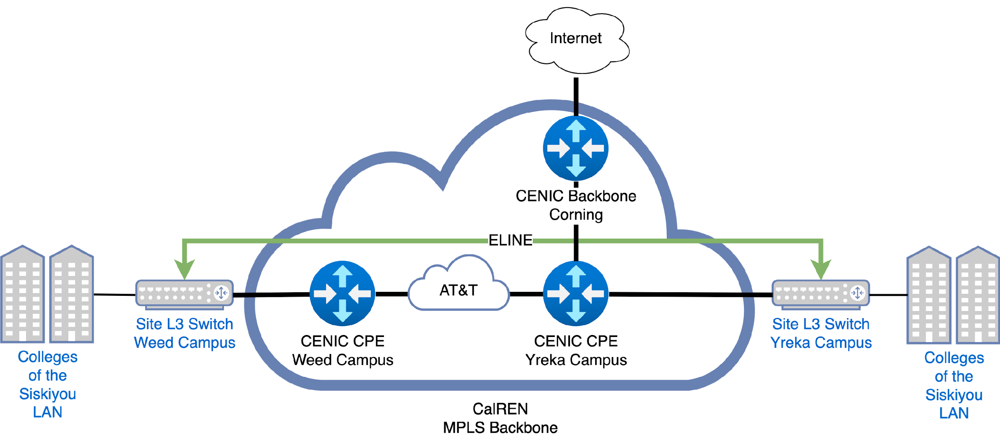
L2VPN – E-LINE
Use to extend layer 2 networks between 2 remote locations
Use case: Transparently connect two locations
Fiber-like connection between locations – with less cost than dark fiber
Notes:
ELINEs are used to extend a Layer 2 network across a Layer 3 backbone (such as CalREN)
ELINEs are point to point, connecting exactly one location to one other location
This is done using an EVPN overlay through our Segment Routed MPLS network

Slide 38
L2VPN – E-LINE
Case Study
Connect remote campuses without routing or extra hardware
Recently provisioned Weed Campus and Yreka Campus E-LINE for Colleges of the Siskiyou
Notes:
While this sounds complicated, from the member perspective, it looks exactly like their two locations are directly connected - CENIC is completely invisible
One interesting use-case is the hub and spoke design that the community colleges use
Generally, the main campus will have their security appliances, while the smaller remote sites do not
We provision ELINEs (or ELANs, which I’ll go over next) from remote site - main campus, which allows them to move all their satellite locations behind one central firewall
This significantly reduces costs as compared to needing firewalls at each location
Another major use-case is cloud connectivity

Slide 39
CENIC Rapid Private Interconnect (RPI) over E-LINE
E-LINE
VPC Router
CalREN
Site Private Cloud
Dedicated Port
Dedicated Port
CENIC
Associate
CalREN
Edge Router
E-LINE
VPC Router
Site Private Cloud
Notes:
As cloud applications become more and more common, members need seamless direct layer 2 connectivity to their cloud providers, such as Azure, AWS, Oracle, or Google Cloud
When this is required CENIC provisions an ELINE from the member handoff router port across the CalREN network and hands off directly to the cloud provider

Slide 40
MPLS VPN Services
Layer 2 Virtual Private Networks
E-LAN
Notes:
The next new service is an ELAN, which is very similar to an ELINE

Slide 41
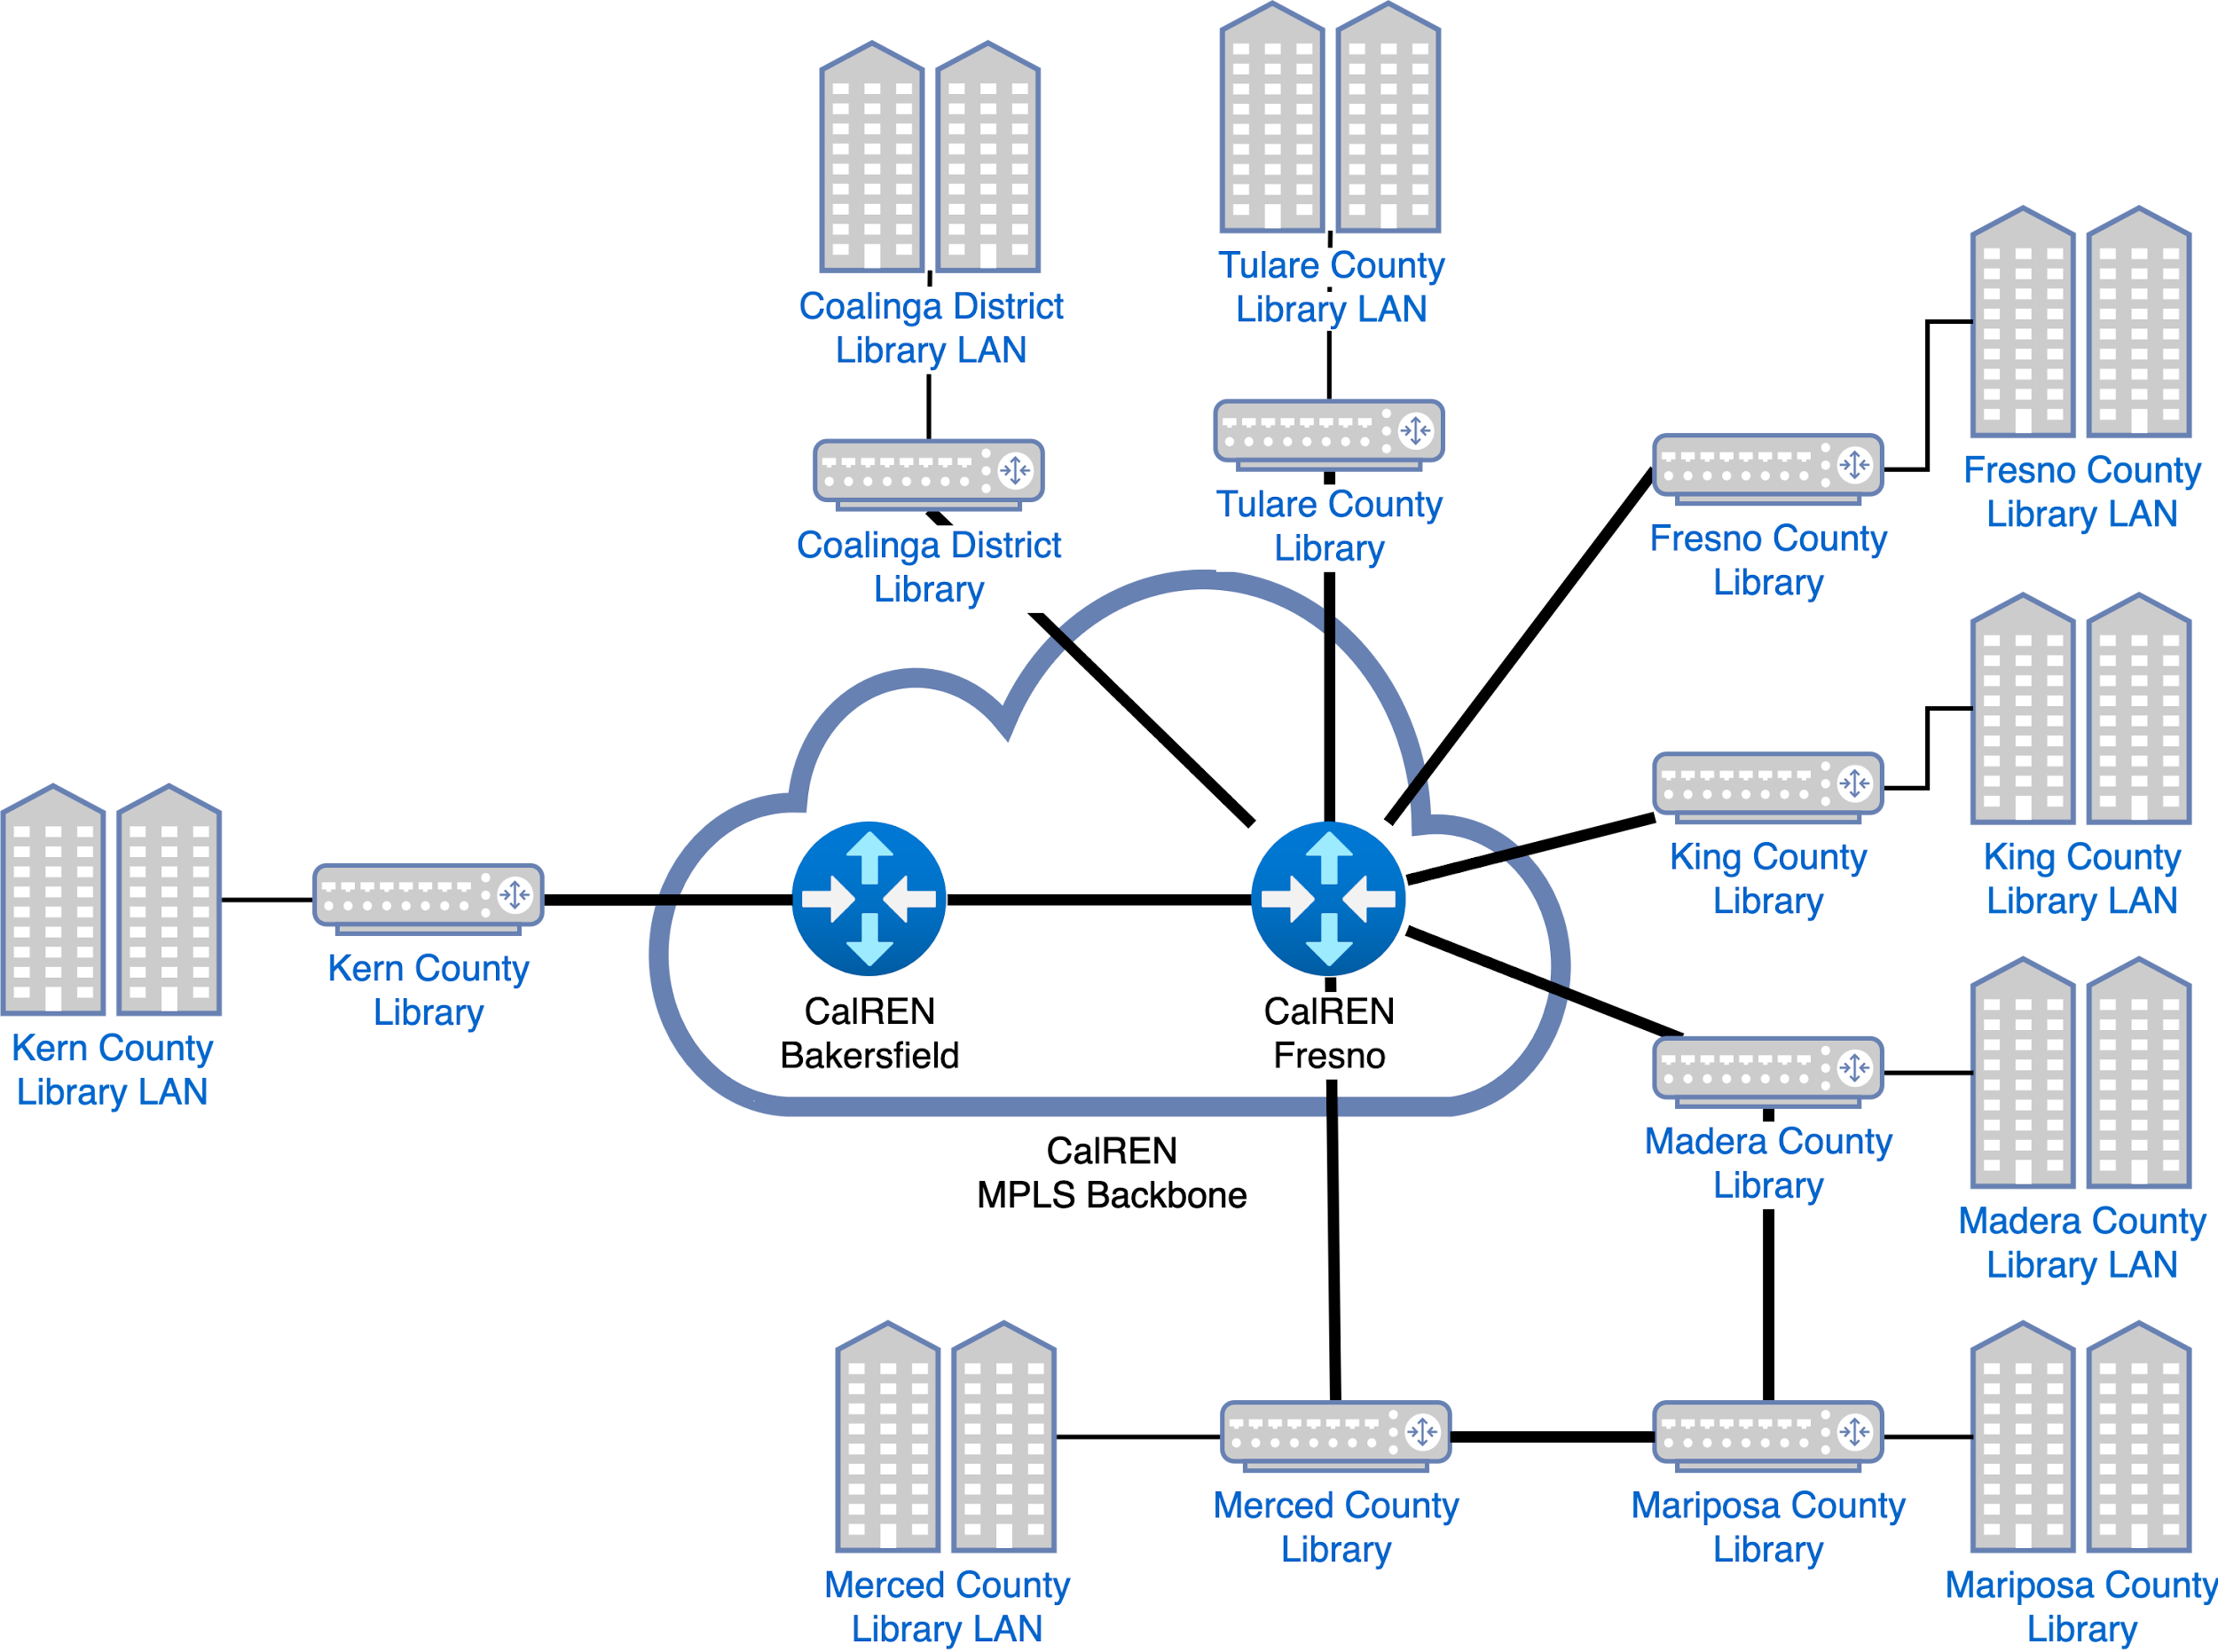
L2VPN – E-LAN
Use to extend layer 2 networks between 2 or more remote locations
Use case: Transparently connect three or more campuses
Let us do the switching for you
Notes:
Where an ELINE is explicitly a point-point service, an ELAN is multi-point, and therefore more flexible
Any number of member locations can be connected together using this ELAN
from the member perspective, it looks like they’re connecting to one big virtual CENIC switch
this is true even across CENIC backbone locations, in other words, the member locations do not need to connect to the same CENIC router

Slide 42
L2VPN Private Network Service – E-LAN
User View
Coalinga County Library LAN
Tulare County Library LAN
Fresno County Library
Fresno County Library LAN
Coalinga County Library
Tulare County Library
King County Library
King County Library LAN
Kern County Library
Madera County Library
Kern County Library LAN
Madera County Library LAN
Merced County Library
Mariposa County Library
Merced County Library LAN
Mariposa County Library LAN
Notes:
This can offer significant cost savings. The example above is of San Joaquin Valley Library system, which needs layer 2 connectivity between all their distributed branch offices
Before ELANs were available, this would have required significantly more physical circuits, greatly increasing costs
With a single ELAN, each branch gets one circuit to a CENIC location, and automatically gets that layer 2 connectivity to all other branches
This offers a very simple, easy to grasp network design with most of the complexity taken on by CENIC for a much lower cost the the library system

Slide 43
E-LAN and E-LINE Comparison
SERVICE TYPE | E-LINE | E-LAN
CONNECTION | Point-to-Point | Multipoint-to-Multipoint
ASSOCIATE VIEW
CENIC VIEW
EXAMPLES
Virtual LAN Switch
Virtual Leased Line
Los Nettos
San Joaquin Valley Library System
Coalinga District Library
Madera District Library
Fresno County Library
Mariposa County Library
Los Nettos Site 1
Los Nettos Site 2
Kern County Library
Merced County Library
Tulare County Library
Notes:
here’s a table comparing ELINE vs ELAN
you may be wondering why not just use an ELAN in all cases?
Well, in general an ELINE will transparently forward all frames between the two locations
An ELAN is a bit more complicated because the CENIC network now has to be involved in frame flooding, just like a switch does
This means there are some types of frames that will not work correctly through an ELAN, but this is fairly rare

Slide 44
CENIC DDoS Mitigation Service (DMS)
Notes:
one of the major challenges for our members the past few years has been DDoS attacks
CENIC was able to act as a consortium, purchasing DMS services for our members, which are often too expensive for any one campus to procure on their own
18 minutes to here

Slide 45
DDoS Mitigation Service (DMS)
DDoS Mitigation Service: A managed solution that works to clean CENIC’s traffic by Internet2’s Radware DDoS scrubbing infrastructure. Scrubbing centers are located in the US.
DDoS Mitigation Service: A managed solution that works to clean CENIC’s traffic by Internet2’s Radware DDoS scrubbing infrastructure. Scrubbing centers are located in the US.
Member
Member
INTERNET
CalREN
INTERNET
CalREN
Outbound Traffic
DDoS Traffic
Clean Traffic
Outbound Traffic
DDoS Traffic
Clean Traffic
Notes:
CENIC works with Internet2 to provide the DMS, or DDos Mitigation Service, to our members
The way this works is that when a member is under attack, CENIC or campus engineers will advertise a IP prefix in BGP towards Internet2 that contains the IP or IPs being attacked
This prefix will then be routed towards Radware, the DMS scrubbing provider, who then returns cleaned traffic straight to CENIC and then back to the member

Slide 46
DDoS Mitigation Service (DMS)
Protects Against
Radware’s DMS Product Mitigates Volumetric Attacks that Operate at the Network and Transport Layer of the Open Systems Interconnection (OSI) Model.
Protection is Offered Against DDoS Attacks that Target Network Infrastructure and Equipment in an Effort to Overwhelm Bandwidth and Session Handling Capacity.
Does Not Protect Against
Other Types Of Cyber Attacks → Generally Targeting the Application Layer
Ransomware/Malware
SQL Injection
Cross-Site Scripting
Notes:
This is primarily for volumetric attacks, but also helps with several other attacks

Slide 47
DDoS Mitigation Service (DMS) – Options
Operationally & Technically Identical
Differing Responsibilities for Monitoring & Response Activity
CENIC Managed Solution
Self-Service Solution
Subscriber of CENIC’s DDoS Mitigation Service
CENIC will perform the following:
All Technical Setup to Support Mitigation Routing
DDoS Detection of Volumetric Attacks
Activation of Mitigation Scrubbing Services - Upon Customer Approval
Provide Quarterly Reports of Mitigation Activity
Downstream Tenant of Internet2/Radware
Direct Access to the Service Provider Security Operations Center (SOC):
Initiate Scrubbing
Portal Access to Review Mitigation Efforts and Reporting
Direct VRF
Responsible for Own DDoS Detection and Activation of Mitigation Scrubbing Services
Notes:
We offer two flavors of DMS to our members
First is the CENIC managed solution where CENIC monitors for DDoS attacks and initiates scrubbing towards Radware on behalf of the member
This initiation is only done after the member gives permission, but in some cases they give pre-approval with the goal of mitigating the attack as quickly as possible
Secondly, the other option is the self-service solution
In this case, CENIC’s involvement is to provision a Layer 2 VPN (an ELINE, like we saw earlier) from the member router towards Internet2
The member then turns up a new BGP peering with Internet2, and during an attack, will advertise the attacked IP prefix themselves
For either option, Radware scrubs the traffic and returns the clean traffic back to the member

Slide 48
Layer 1 Services
Optical Service
Notes:
Another major service area is on the optical side

Slide 49
Optical Service
Gets you from here to there and back on top of dark fiber, with no layer 2 or layer 3 equipment in between
Any network can be run over the top of an optical service
Example: 400 Gigabits per second of capacity between Los Angeles and Sunnyvale
Notes:
A layer 1 optical service is something that CENIC has offered for many many years
This service is a DWDM wave between two locations
In a sense, it’s very similar to the ELINEs that we saw earlier, which were the point-point VPN services
In fact, a large reason the pre-NGI CalREN had so many optical services was actually because we were unable to offer ELINE services
Now that Layer 2 VPNs are commonplace, in many if not most cases, the ELINE is the better option for our members
Generally, optical remains the preferred choice for dedicated high-bandwidth requirements, such as a 400G service from LA to San Diego

Slide 50
Metro Optical Services
Notes:
We also have a new optical service offering - Metro optical

Slide 51
Metro Optical Solutions
CENIC currently manages 33 WAN optical circuits connecting associates to CalREN over dark fiber
While optical networking is a critical component of CalREN, it is typically a lower priority for CENIC Associates
Many associates do not have engineers with optical experience on-staff
CENIC is now able to offer a metro optical solution, in which CENIC manages an associate’s non-CalREN connecting optical network
This design is an optional addition to WAN optical solutions
At this time, CENIC is only able to offer metro optical services using CENIC approved hardware and software
Notes:
Since CENIC spends so much time on our large optical network, all of our 40 or so network engineers have a high amount of optical experience
Our members often do not, simply because DWDM is a much lower component of their network
To help with this, CENIC now offers a metro optical solution
This differs from the traditional optical service in that the metro solution generally does NOT connect back to CalREN
In other words, CENIC is helping to manage the Layer 1 portion of a member’s internal network

Slide 52
Metro Optical Example
Site 1
Site 2
Nx100G Clients
Three 400G trunk circuits over dark fiber (ranging from 15-85km)
CENIC manages the optical hardware, while the Associate manages the directly connected switches
2x100G client handoffs provisioned initially
Ability to grow up to 3x400G per span (12x100G clients per optical device)
400G Trunk
400G Trunk
400G Trunk
Nx100G Clients
Nx100G Clients
Site 3
Site 4
Site 5
Notes:
Here is the first production case of this metro service
In this design, three fiber spans are managed by CENIC using Ciena Waveserver platforms
We provisioned 400G trunks between the 5 Waveservers, and connected the waveservers down to member-managed switches
Again, none of these circuits connect into CalREN, this is exclusively for that member’s network

Slide 53
Metro Optical - General Scope of Work
CENIC works with Associate to gather requirements
CENIC selects appropriate hardware and software, using standardized CENIC platforms
Bill of Materials shared with Associate for review and approval
CENIC procures hardware and software
CENIC deploys and turns up the equipment
CENIC provides handoffs to Associate
CENIC operates the optical network and dark fiber 24x7x365
Moves, Adds, Changes, Deletes (MACD) are handled separately as needed

Slide 54
WAN Optical Updates

Slide 55
WAN Optical Updates
CENIC has traditionally provided Layer 1 services to connect Associates over dark fiber to CalREN, typically using a complete optical line system
We can now provide more flexible service offerings based on the fiber and associate requirements
Optical Line System categories:
OLS Full
OLS Lite
OLS Free
Transponder categories:
IPoDWDM
Discrete TXPs

Slide 56
Optical Line System
OLS Full
OLS Lite
Three solutions:
OLS Full
OLS Lite
OLS Free
OLS Full provides the most flexibility, with support for very long spans, rings, and more than two degree nodes
OLS Lite provides simpler fiber management, typically only applicable for point-point designs
OLS Free is for short spans that only require a transponder solution

Slide 57
Transponders
IPoDWDM
Discrete TXPs
Two solutions:
IPoDWDM
Discrete TXPs
Each solution would be combined with an OLS solution in the previous slide
IPoDWDM uses a ZR or similar optic in a CENIC or Associate managed router/switch
Discrete TXPs use independently managed transponders, such as Ciena Waveservers or Cisco NCS1014s

Slide 58
CENIC AIR
Notes:
One of the most important new services is CENIC AIR, the CENIC AI Resouce
21 minutes to here

Slide 59
FAQ 1.1: What is CENIC AIR?
CENIC AIR is the CENIC-connected part of the National Research Platform (nrp.ai) providing California’s R&E communities a means for faculty and students to
develop and refine topical AI curricula,
contribute to the transformations promised by these new technologies and,
collaborate extensively with colleagues nationwide over the NRP infrastructure.
It adds CENIC’s network planning, engineering, and operations activities toward expanding AI resources to instructional as well as research-focused campuses.
It also adds CENIC Communications: Telling the CENIC AIR story across media channels to reach, educate, and inform multiple audiences.
Notes:
CENIC AIR is the California portion of the National Research Platform with a focus on increasing and expanding access to AI resources
It’s a collaborative effort between campuses and universities to share a distributed compute and storage cluster optimized for data science and AI applications

Slide 60
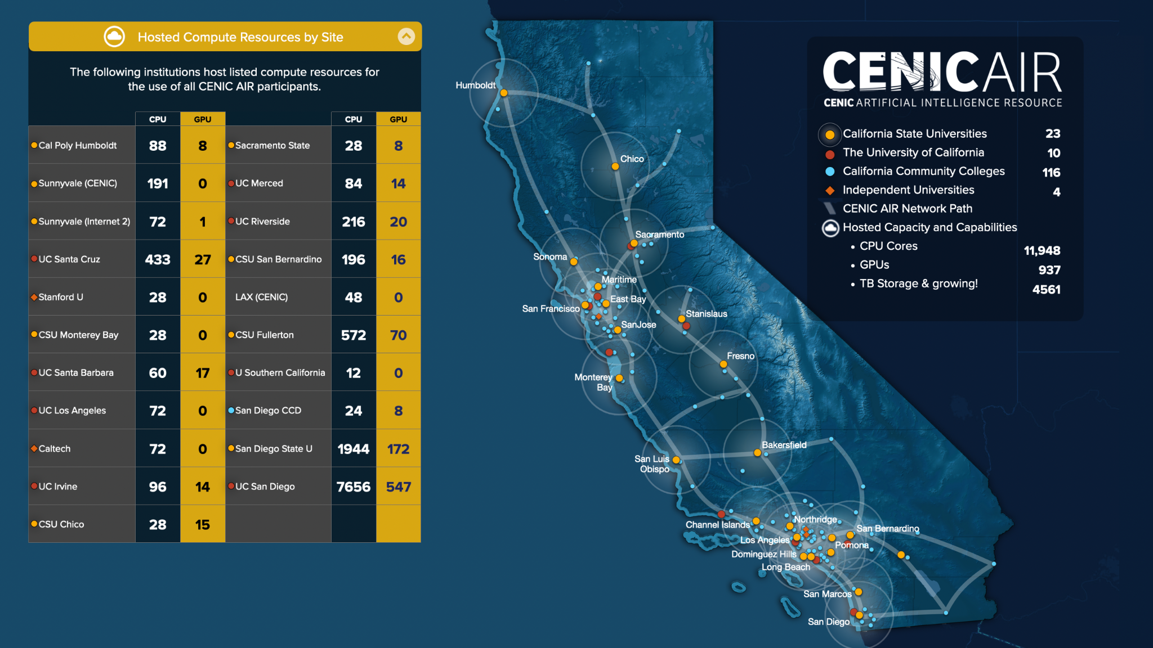
CENIC AIR
CENIC AIR consists of high-performance compute and storage infrastructure voluntarily contributed to by members of the CENIC community.
“The most powerful and heavily used section of the National Research Platform (NRP)”
References:
CENIC AIR
https://cenic.org/news/learn-what-cenic-and-our-members-accomplished-together-in-the-cenic-2022-24-community-report
Notes:
students at California institutions can access these resources using the Nautilus application, which is managed by UC San Diego
When CENIC members make these GPU and CPU resources available to CENIC AIR, UC San Diego actually manages the servers centrally
In addition to ensuring the servers are appropriately secured and hardened, this also makes all resources available to all Nautilus users
Users do not have to host CPU or GPU resources to make use of CENIC AIR, but when a campus does host, not only does it benefit the rest of the community, but their students get priority to their local resources and demand can burst to other nodes

Slide 61
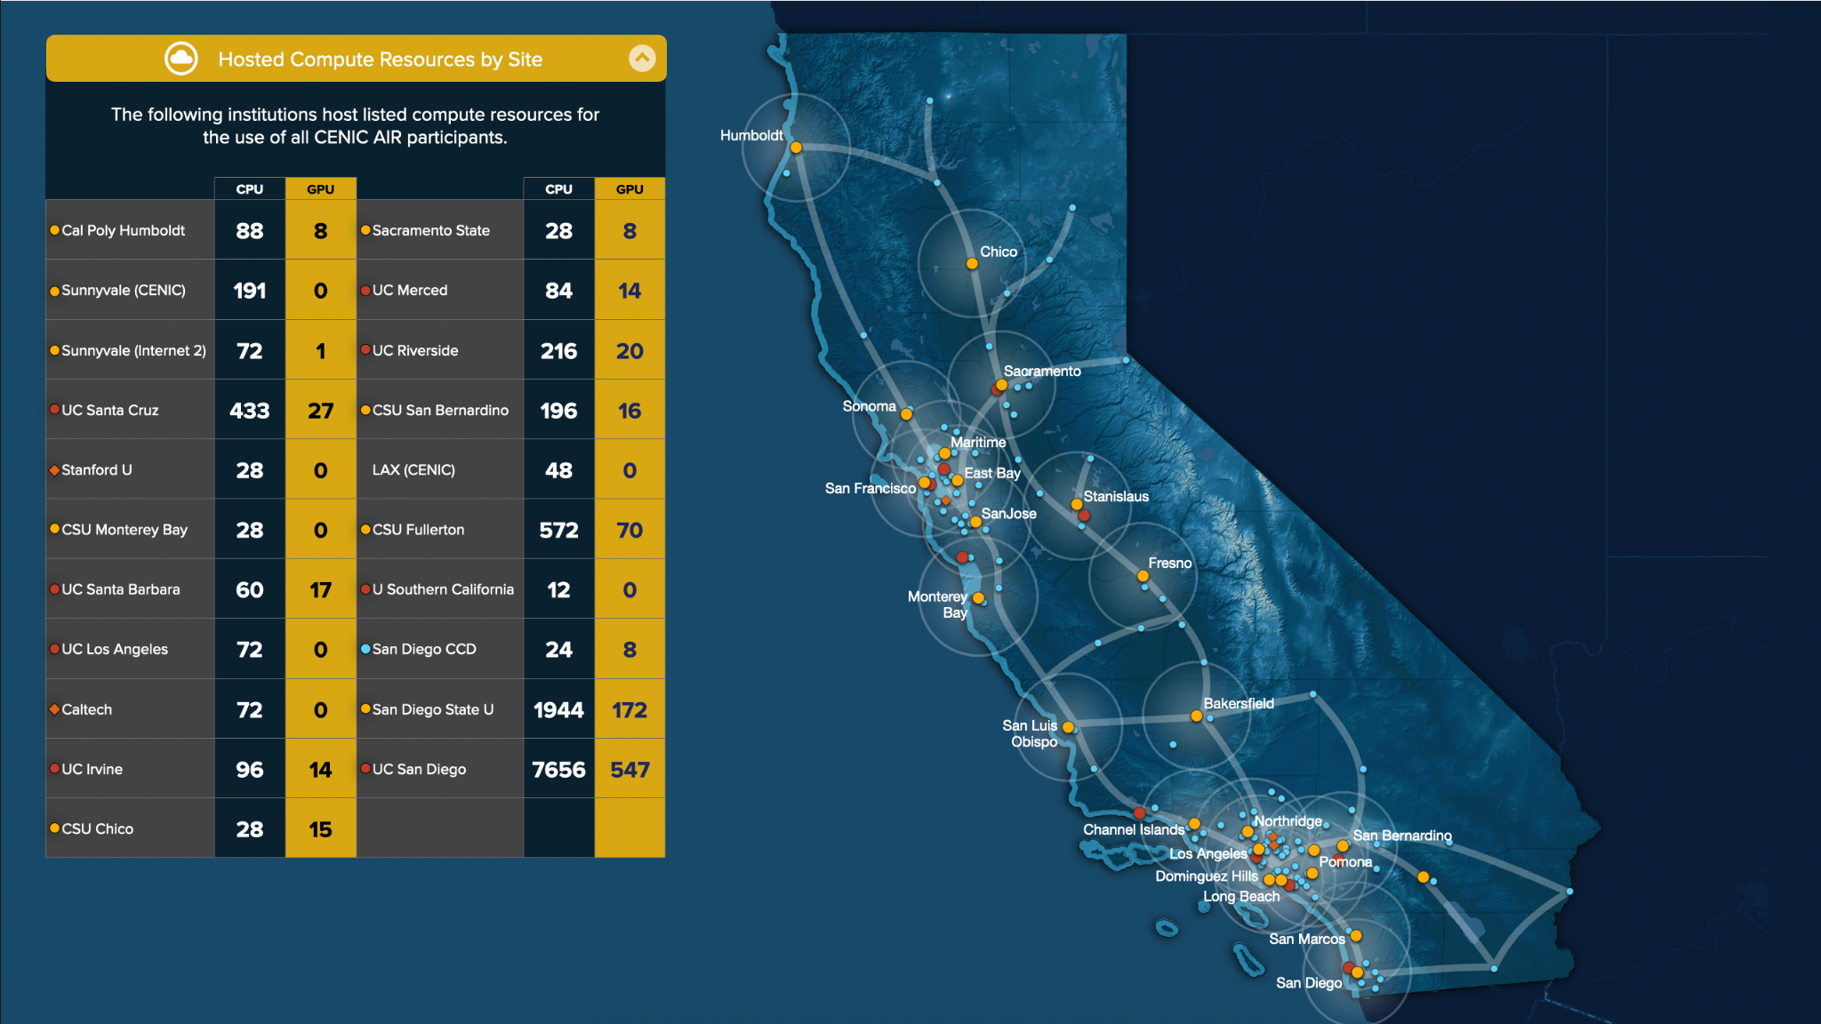
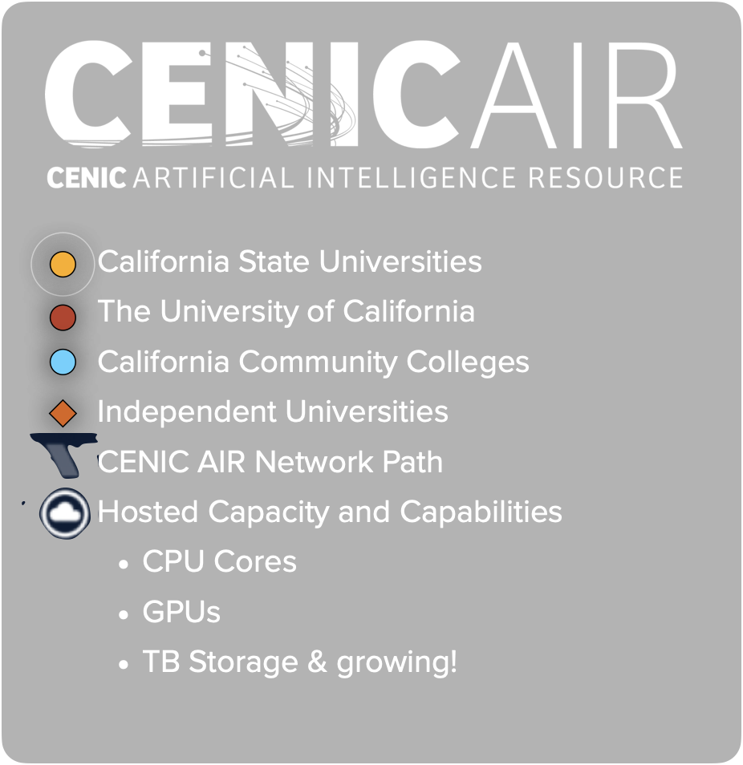
23
10
116
4
11,948
937
4561
The Majority of Nautilus GPUs Reside in the CENIC AI Resource (CENIC AIR): Hosted by and Available to CENIC Associates
Notes:
this is a view of the CPU and GPU resources available to CENIC AIR as of last year
A notable change over the past 9 months has been the increasing interest by the Community Colleges and CSUs
Traditionally, a resource like CENIC AIR would typically only be consumed by the R1 institutes
With all of the interest in AI, several CSUs have started turning up new nodes, as well as community colleges
San Diego Community College was the first, with LA Community College shaping up to be the next one

Slide 62
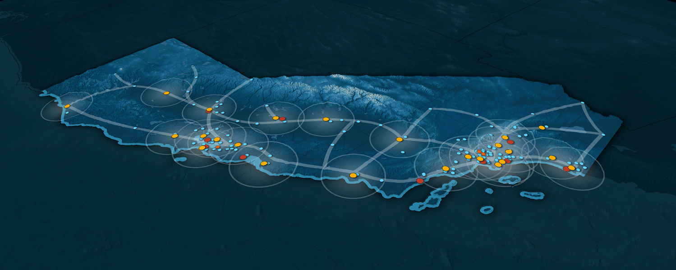
The Majority of NRP’s Nautilus GPUs Reside in the CENIC AI Resource (CENIC AIR):
Hosted by and Available to CENIC Members
UC Riverside
CENIC ADD/DROP
CENIC CAMPUS SITES
CENIC NON-CAMPUS SITES
227
24
431TB
C
P
U
G
P
U
CSU Chico
Sacramento State (soon)
28
8
0TB
CSU San Bernardino
C
P
U
G
P
U
28
8
0TB
Palo Cedro
C
P
U
G
P
U
196
16
0TB
Chico
C
P
U
G
P
U
Corning
UC Merced
CSU Fullerton
Humboldt
Sacramento
84
15
0TB
Colusa
C
P
U
G
P
U
572
72
0TB
Merced
C
P
U
G
P
U
Cal Poly Humboldt
Emeryville
Sunnyvale
Fresno
Riverside
88
8
0TB
Palm
Desert
El Centro
C
P
U
G
P
U
Bakersfield
Fullerton
San
Francisco
Palo
Alto
Soledad
Santa
Cruz
Monterey
Los
Angeles
816 GPUs; 11,417 CPU Cores; 4561 TB Storage and Growing!
San Luis
Obispo
San
Diego
Joining CENIC AIR
gives the user access to:
Sunnyvale (CENIC)
Santa
Barbara
UC Los Angeles
UC San Diego
C
P
U
G
P
U
48
0
0TB
C
P
U
G
P
U
UC Santa Barbara
72
0
0TB
C
P
U
G
P
U
7568
521
2386TB
CPU cores/site
Sunnyvale (Internet2)
124
12
129TB
C
P
U
G
P
U
UC Irvine
San Diego State U
C
P
U
G
P
U
72
1
240TB
C
P
U
G
P
U
132
14
0TB
C
P
U
G
P
U
GPUs/site
1880
127
154TB
Stanford U
Caltech
32
0
318TB
Storage TB/site
C
P
U
G
P
U
72
0
350TB
C
P
U
G
P
U
UC Santa Cruz
LAX (CENIC)
433
28
594TB
Surrounded by additional resources in the:
National Research Platform
Open Science Grid
San Diego Supercomputer Center
Commercial Clouds
C
P
U
G
P
U
48
0
240TB
C
P
U
G
P
U
CSU Monterey Bay (soon)
28
8
594TB
C
P
U
G
P
U
CENIC 7/3/2024
Notes:
this is a view of the CPU and GPU resources available to CENIC AIR as of this past july
students and researchers don’t have to host these resources to take advantage of CENIC AIR, but hosting does give priority

Slide 63
What resources do Nautilus nodes need?
CENIC CalREN
CalREN DC (Digital California)
Internet access
OS and software updates
DNS/NTP/etc.
Standard MTU (1500 bytes)
CalREN HPR (High Performance Research)
Nautilus infrastructure and other nodes
Jumbo MTU (9000 bytes)
DC and HPR are separate networks with separate routing tables.
DC
HPR
NRP Nautilus Nodes
Notes:
campuses do not need to do anything specific to connect to CENIC AIR, but for those hosting, CENIC is able to offer a few services to make this easier
first, these Nautilus nodes need access to the CalREN DC network. This is used for OS and software updates, access to git repositories, and so on
Secondly, CalREN HPR is used for data transfer between nodes and from Nautilus nodes to the user

Slide 64
Science DMZ Design Options - Traditional Model
Internet
Other Science DMZs
CENIC CalREN
Campus maintains separate BGP sessions for DC and HPR
Science DMZ routing for Nautilus is the campus’s responsibility.
Many campuses still use and prefer this model:
Fine-tuned control over routing policy, bandwidth/QoS, and firewall rules.
No CENIC involvement needed in Science DMZ config.
May be complicated to set up from scratch and requires campus network staff to be confident in BGP knowledge.
DC
HPR
DC BGP sessions
HPR BGP sessions
Campus Border Router
NRP Nautilus Nodes
Campus Enterprise
Notes:
Thirdly, Science DMZs are preferred to create a DMZ for the nautilus nodes themselves
Because of the high throughput needs, these Nautilus GPU and CPU nodes should ideally not be behind campus firewalls
Instead, they should have limited access to the DC network and primarily use the HPR network, which by definition has a lower attack surface
The melding of the two networks in this way is called a Science DMZ
Science DMZs can be setup entirely by the campus, but it can be more complex to deploy given the BGP knowledge required

Slide 65
Science DMZ Design Options CENIC-managed routing
Internet
Other Science DMZs
CENIC CalREN
CENIC now offers a dedicated Science DMZ handoff option.
CENIC handles the routing internally.
Handoff from the CPE is simply a local LAN for the Science DMZ with a static default gateway.
No BGP configuration needed.
DC
HPR
DC BGP sessions
HPR BGP sessions
CENIC CPE
Science DMZ Local LAN
Campus Border Router
NRP Nautilus Nodes
Campus Enterprise
Notes:
To help with this, CENIC now offers a third Layer 3 network service for Science DMZs
We have several different options, which primarily depend on the individual campuses’ security requirements
In the CENIC-managed Science DMZ, the routing is handled by the on-site CENIC CPE router, and more simplified handoffs are given to the member
The goal here is just to make CENIC AIR access as streamlined as possible for the member

Slide 66
2x800G Backbone
Final NGI Phase
Notes:
Finally, CENIC has begun the last stage of the NGI effort, the 2x800G backbone project
25 minutes to here

Slide 67
NGI Optical - Overview
Legacy Optical Platform
NCS1010 Next-Gen Line System
+
+
CISCO NCS1010 ROADM Node
400ZRP Coherent Optics
NCS2006 Shelf
4x 100G Transponder
Refresh all legacy optical platforms with the NCS1010 next-gen line system
Improvement of 400G and 800G member optical service deployments
Estimated reductions of 54% and 77% for colocation space and power
Estimated Cisco maintenance spend reduction of 60%
Increase operational visibility and capability, reducing mean time-to-repair (MTTR)
Total fiber capacity of 51.2 Tbps, or 64 800G optical services
Notes:
As we saw earlier, CalREN is currently nearly at 2x400G
Our optical line system is primarily based on the Cisco NCS2006 platform using flex-grid technology
While this has been a very reliable platform, as we start deploying more 400G and greater services, the gaps start to show
We are now in the process of refreshing to the Cisco NCS1010 platform which has many important generational improvements, such as greater and more flexible support for 400G and above services
The new NCS1010s also reduce space and power consumption significantly as well as reduced the annual maintenance spend,
and offer improved operational capabilities, such as built-in OTDRs for enhanced fiber failure detection and troubleshooting
This new platform ultimately means a total capacity of 51.2 Tbps across each fiber, or 64 800G circuits

Slide 68
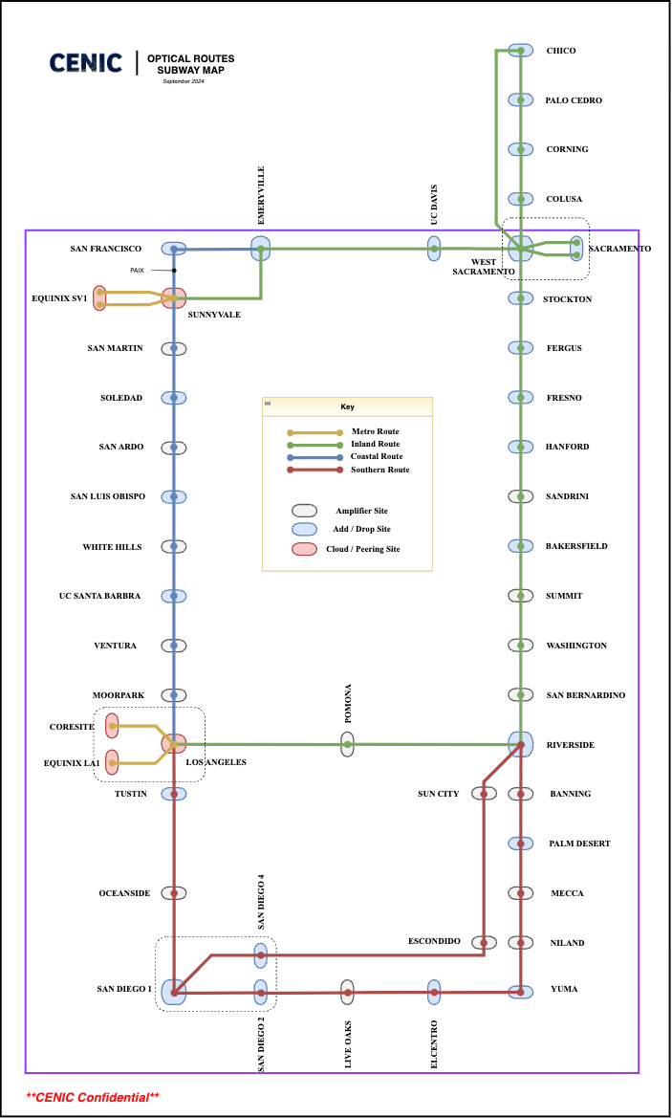
NGI Optical
Project Plan
Foundation of all CENIC services
Methodical planning required to mitigate risks
Initially projected to require four years to complete
26 Add/Drop sites
63 fiber paths total
17 Amplifier sites
236 backbone & member optical services
First year nearing completion
Notes:
Slide purpose: show the complexity of the project
the challenge with this project is that the optical backbone is the foundation for all CENIC services
this image shows the optical diagram that our engineers reference daily
Over 40 sites are being upgraded, but even that number alone is somewhat misleading
Upgrades need to be executed by fiber path, meaning any given site will need 2 to 5 maintenance windows to complete
For example, Riverside has four fiber paths into the data center, so we need at least four different upgrade windows for this one site
This means careful planning and preparation is needed to mitigate risk while performing these complex upgrades
Because of all these challenges, we initially envisioned a four year roadmap to complete this project

Slide 69
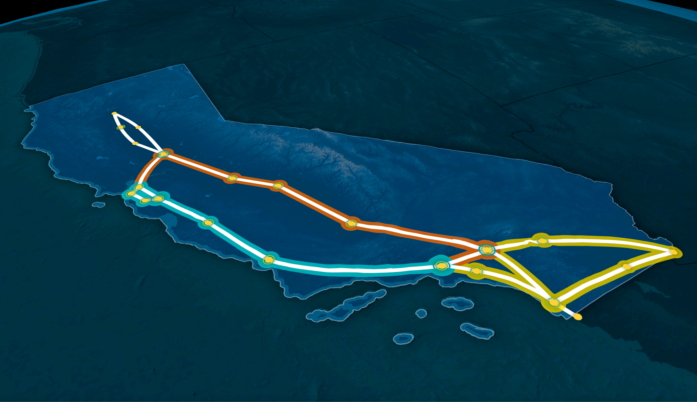
NGI Optical Initial 4-Year Roadmap
Inland Route
16 Add/Drop & 4 Amplifier sites
80+ Optical Services
Projected Start: July 2025
Actual Start: January 2025
Projected End: June 2027
Palo Cedro
Corning
Chico
Colusa
Sacramento
Emeryville/Oakland
Merced
Fresno
San Francisco
Sunnyvale
Palo Alto
Soledad
Bakersfield
Riverside
Palm Desert
Yuma
7 Add/Drop & 5 Amplifier sites
50+ Optical Services
Projected Start: July 2024
Actual Start: July 2024
Projected End: June 2026
San Luis Obispo
Coastal Route
Los Angeles
Tustin
El Centro
Southern Route
9 Add/Drop & 8 Amplifier sites
90+ Optical Services
Projected Start: July 2026
Projected End: June 2028
San Diego
Tijuana
Notes:
slide purpose: show the initial project plan
This shows the initial roadmap as envisioned last year for each of the three optical routes - Coastal, Inland, and Southern, and their projected start and end dates
Because of the criticality of the LA to Sunnyvale path, the Coastal route began first and is already nearing completion after only one year
Additionally, work has already begun on the Inland route, with several major phases already completed - such as the deployment and turnup of the new NCS1010s

Slide 70
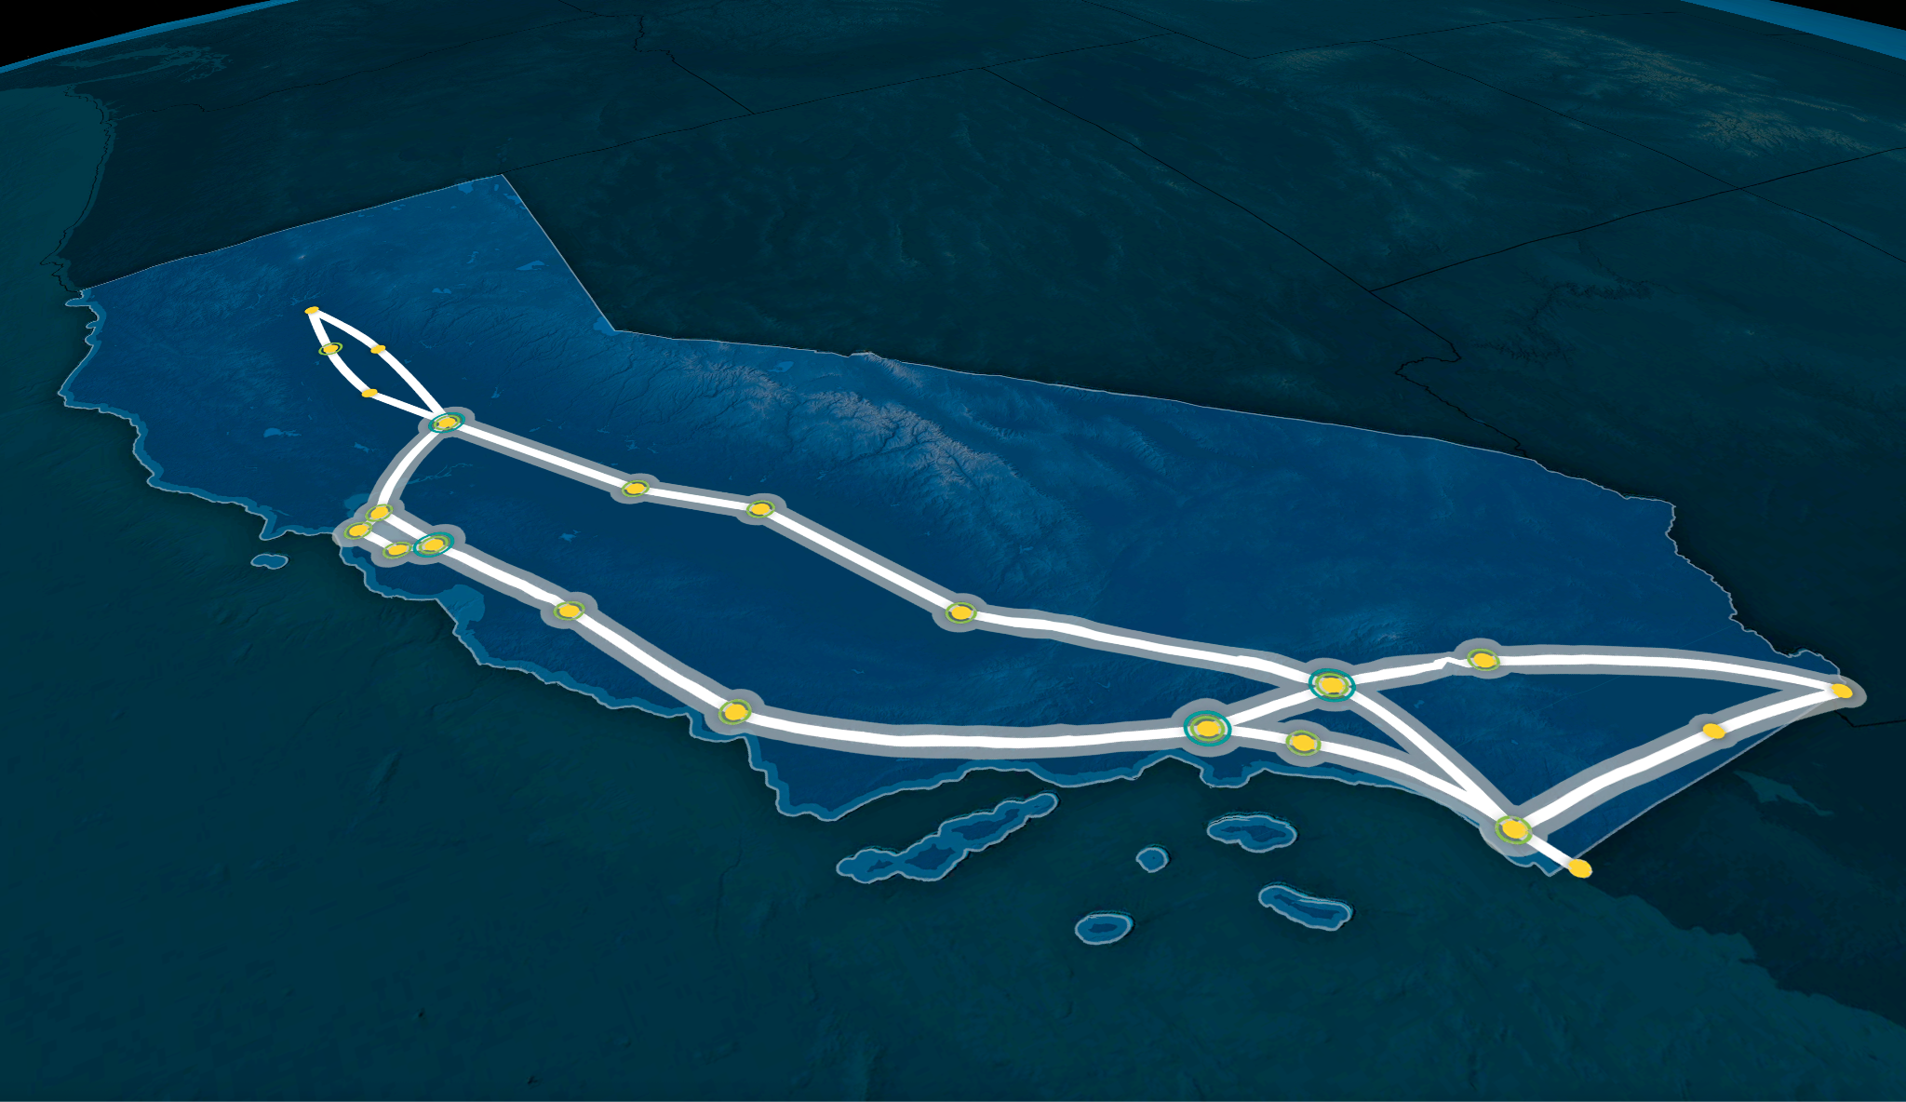
NGI Optical Roadmap Improvements
Inland Route
Design & Purchasing Completed
Line System Deployment In Progress
Service Migration Not Started
New End Date: October 2025
Palo Cedro
Corning
Chico
Colusa
Sacramento
Emeryville/Oakland
Merced
Fresno
San Francisco
Sunnyvale
Palo Alto
Soledad
Bakersfield
Riverside
Palm Desert
Yuma
Design & Purchasing Completed
Line System Deployment Completed
Service Migration In Progress
New End Date: August 2025
San Luis Obispo
Coastal Route
Los Angeles
Tustin
El Centro
Southern Route
Design & Purchasing: Completed
New Start Date: August 2025
New End Date: June 2026
San Diego
Tijuana
Notes:
slide purpose: show current status and new end dates, discuss accelerated schedule
After the first year of this project, we’ve been able to realize significant improvements to our deployment and migration processes while still reducing the risk inherent in network changes at this level of complexity
Some of the improvements we’ve made include
recent customized optical training for both our operations team and the engineering and architecture group
also, strong relationships with Cisco’s optical product team allowed us to work directly with Cisco to iron out bugs and new features with the next gen hardware
this relationship in particular was really important in the technical development of our engineers, which has had a tremendous impact for this project
we’ve also been exploring and implementing automation and small-scale scripting to accelerate deployments
Finally, a somewhat surprising challenge was our dark fiber. On most spans, CENIC obtains at least two pairs of dark fiber. This helps with upgrades like this one, and also allows for flexibility when connecting members to CalREN
The challenge was that in many cases, our fiber vendors struggled to identify these secondary pairs, but our engineers did an excellent job working with these vendors to correct their documentation in less time than expected
All of these improvements will allow us to complete the project in half the originally projected timeframe
Finally, it’s also worth mentioning that the three optical routes will be fully integrated by the conclusion of this project, greatly reducing circuit complexity and enabling more comprehensive management
transition -> in the next few slides we will talk about the changes at Layer 3 that will allow us to best take advantage of this optical NGI project

Slide 71
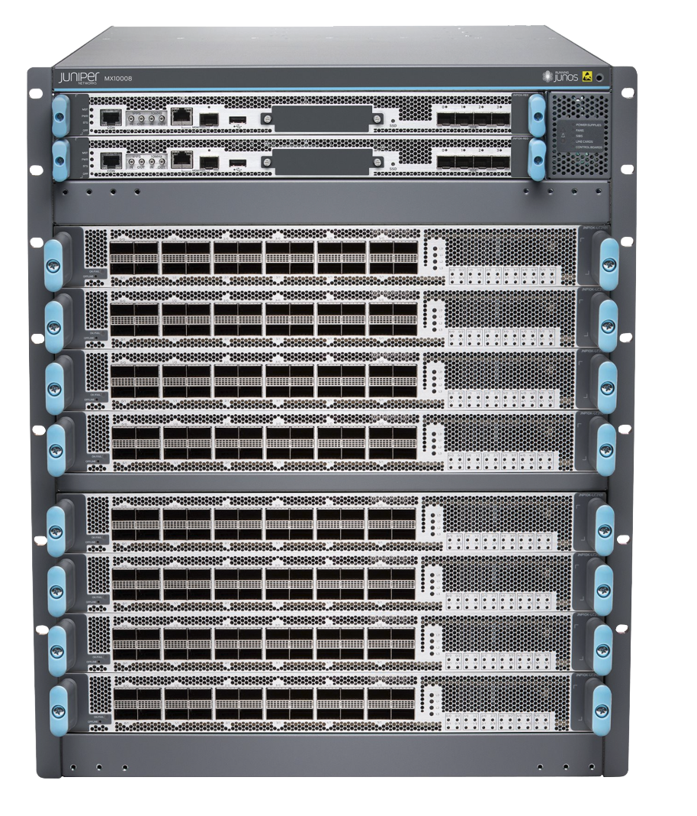
NGI Routers - Overview & Status
Current 400G-Based Backbone Router: Juniper MX10008
Does not support 800G services today
Next-Gen 800G-Based Backbone Router: Juniper PTX10002
Native 800G support
Distributed design offers greater flexibility and cost-effective upgrade cycles
Automation leveraged to offset the more complex topology
400G-Based Platform
800G-Based Platform
Juniper MX10008
Native 100G / 400G Support
Modular Linecards and Routing Engines
Monolithic Design
Juniper PTX10002
Native 100G / 400G / 800G Support
Chassis-based System
Distributed Design
Notes:
slide purpose: ptx gives us 800G capability
Our current backbone router that we use to deliver 400G services is the MX10008 platform from Juniper
In order to achieve 800G capability, we needed an upgrade
Anytime we need to do this, we look at feature sets and costs for many different platforms and vendors to find the best fit for CalREN’s needs
Upgrading the existing MX10008s, besides just the high-cost, also required waiting at least another year for the 800G hardware to become available, and the upgrade itself requires replacing many internal components in a very challenging maintenance window
Alternatively, the new PTX10002, also from Juniper, was significantly easier, and therefore less risky, to deploy and much more cost-effective compared to the older MX10008 platform
Additionally, the MX10008 has a more monolithic, ‘all-in-one platform’ design, where all or at least most services within a location are aggregated onto it
This makes for simpler designs but at the cost of flexibility and potentially painful upgrades
The PTX, on the other hand, offers a much more distributed architecture for greater flexibility and faster upgrade cycles while still remaining very cost-effective and enabling 800G service opportunities
Much of the additional complexity with this new design will be offset by CENIC’s automation efforts
transition -> these routers will also allow us to take advantage of several key advancements at the optics layer

Slide 72
NGI DWDM
Solutions
OPTION 1 - Transponder
NCS1004 Transponder Shelf
400G+ Transponder
+
Two options
Transponder
DWDM optic
Transponders
Higher cost, more capable
Best for longer fiber spans
DWDM Optics
Cost-effective
Perfect for most of the CalREN fiber spans
800G-capable Juniper PTX10002
OPTION 2 - DWDM Optics
800G DWDM Optic
(No Transponder Shelf Needed)
Notes:
slide purpose: quickly talk about optics, focus on DCO
DWDM solutions are one of the most critical considerations of any upgrade cycle because the capabilities of the chosen router platform directly affect the available options
When connecting two routers in different locations together, standard optics do not work in most cases - the distances are just too great
The two main solutions for this are DWDM transponders or DWDM optics, also called IPoDWDM
Both solutions enable long distance connectivity between routers and sites
The traditional way to create this connectivity is using DWDM transponders, shown at the top right
These transponders require discrete hardware that, while very capable, is also more costly compared to DWDM optics, which are somewhat less versatile, but very cost-effective and require no additional hardware
Generally, DWDM optics are perfect for shorter spans, such as LA - San Diego, while transponders are best suited for longer spans, such as LA - Sunnyvale
The majority of backbone and member connections can benefit from these DWDM optics, whether at 400G or 800G
Because of the high value of DWDM optics, any viable router solution was required to support 800G DWDM optics, which the PTX10002 does and this was a key reason why it was selected
transition: Next, let’s review how these routers and optics are used on the CalREN backbone

Slide 73
Current Backbone:
400G-Based
Sunnyvale
Emeryville
Sacramento
All spans except two are at 2x400G today
The remaining spans will be completed June 2025
Current design uses MX10008 routers with 400G-based line cards
MX10008 2x400G Core Ring
Riverside
Los Angeles
Tustin
San Diego
Notes:
slide purpose: show the current 400G design
This represents the CalREN layer 3 network today, specifically the 400G-based ring that we refer to as the ‘Core Ring’
Every link will be 2x400G by this coming June and all but two links (LA to Sunnyvale and Riverside to Sacramento) use 400G DWDM pluggable optics directly in the routers
this makes capacity increases very fast and cost-effective
transition - in order to keep that same flexibility at 800G, we have a new design we’re finalizing

Slide 74
Future Backbone:
800G-Based
Sunnyvale
Sacramento
Cost-optimized design
PTX10002 800G Routers
DWDM Optics
Improved upgrade cycles
Faster adoption of newer speeds and technologies
Initial 800G locations:
LA, Sunnyvale, Sacramento, and San Diego
Additional locations will be upgraded as demand requires
All other locations can still use 800G optical services
PTX10002 2x800G Core Ring
Los Angeles
San Diego
Notes:
slide purpose: show Fady’s new design
This final phase of the NGI effort will be the 2x800G backbone
As our engineers began planning for this, we wanted a design that improved the flexibility of the network while allowing for a phased approach to 800G but still keeping the same resiliency of today’s 400G based core ring
In this phase, we’ll deploy the PTX10002 routers at each of the 4 hubsites shown here, creating a ‘super core’ ring
The 400G circuits as shown in the previous slide will largely be left as shown there, as the low cost of DWDM optics used makes this very advantageous
On top of this, we will deploy 800G services to create a fully diverse 800G-based backbone, with additional 800G locations easily added as demand requires
Not only does this give us all the benefits of a true 2x800G, or 1.6Tbps, network but also greatly improves future upgrade flexibility
transition: what does all this information mean?

Slide 75
NGI 800G - Member Benefits
Upgraded from 100G to 800G, skipping 400G, reducing lifecycle costs and doubling the capacity for similar costs as 400G
The strategies, designs, and lessons learned through the NGI project made for a smooth transition to 800G for SDSU
Legacy 100G
Solution
CENIC MX10008
100G Transponder
Legacy NCS2006
Legacy NCS2006
100G Transponder
SDSU Router
Next Gen 800G
Solution
CENIC PTX10002 +
800G DWDM Optic
Amplifier
Amplifier
SDSU PTX10002 +
800G DWDM Optic
Notes:
slide purpose: show how NGI helped make the SDSU project trivial
This 800G NGI effort recently culminated in the first 800G member connection in the R&E community for San Diego State University
Last year, SDSU came to us about upgrading their connection to CalREN to better support CSU TIDE and other initiatives, and we ultimately recommended moving straight to 800G
As a result of the NGI efforts, we were able to deliver this service for a similar cost as a 400G upgrade
Moving straight to 800G also greatly reduces overall lifecycle costs by skipping the 400G step
While the NGI effort that’s been discussed in this presentation up to now has been focused on the CalREN backbone, the strategies and processes developed by our engineers directly translated to this project
Additionally, we were able to leverage our partnership with Juniper to obtain 800G DWDM optics ahead of the general release schedule, allowing this project to complete 2-3 months earlier than expected
Because of this and the lessons learned during the NGI effort, we were able to work with SDSU to seamlessly upgrade them to 800G
In the final phase, we will completely replace SDSU’s legacy NCS2006 optical line system with just two simple optical amplifiers, reducing not just cost but also network, configuration, and operational complexity
Even today though, adding new services is just a simple matter of two new optics
This 800G NGI effort recently culminated in the first 800G member deployment for CENIC at SDSU, and we believe it’s the first in the R&E community
While the NGI effort that’s been discussed in this presentation up to now is focused on the CENIC backbone, the strategies and processes developed by our engineers directly translated to this project
Our engineers were able to work with SDSU to very quickly make necessary upgrades to SDSU’s optical hardware to support 800G
Simultaneously, we were able to use our relationship with Juniper to obtain loaner optics ahead of general availability, completing the deployment 2-3 months faster than expected
Once this was completed, deploying the new 800G was a simple matter of connecting two 800G ZR+ optics up to the line system
In an upcoming future phase, we will be fully decommissioning SDSU’s line system in favor of simple, but versatile, EDFA amplifiers
In other words, all of the complexity is at the router and optic layer. Adding new 400G or 800G services is a simple matter of adding a new pair of optics
This design not only reduces costs and network complexity, but also the configuration and long term operational lifecycle aspects
Finally, this project allowed SDSU to effectively ‘skip’ an entire upgrade cycle, moving from 100G-based services directly to 800G

Slide 76
Thank you!
Notes:
full rehearse #1 - 36m

